Slide 1

LET YOUR VOICE BE HEARD COMMUNITY FORUM
02/28/2017

Slide 2
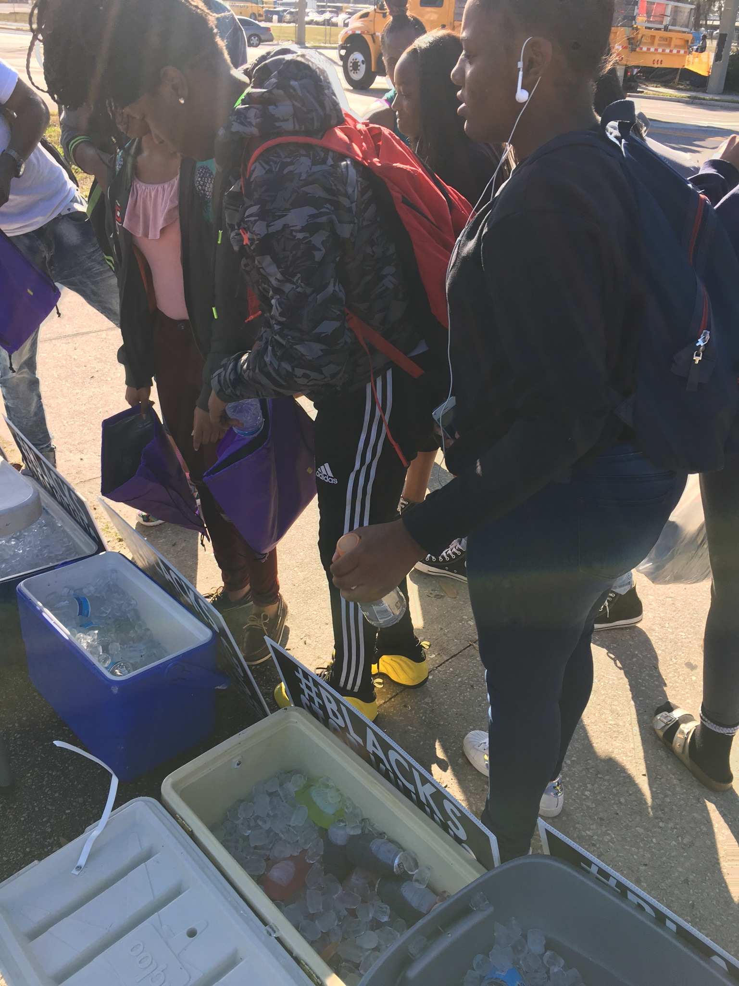
LET YOUR VOICE BE HEARD COMMUNITY FORUM
ONE OF THE MAIN GOALS OF OUR COMMUNITY FORUM IS TO BUILD CONNECTIONS WITHIN THE CITY
PLEASE INTRODUCE YOURSELVES
THERE IS A SIGN IN SHEET AT THE FRONT OF THE ROOM IF YOU WISH TO SPEAK
We will hold all announcements and topics until the end of our presentation so that the whole presentation is completed and everyone can speak at the end
Please sign up if you have an announcement

Slide 3
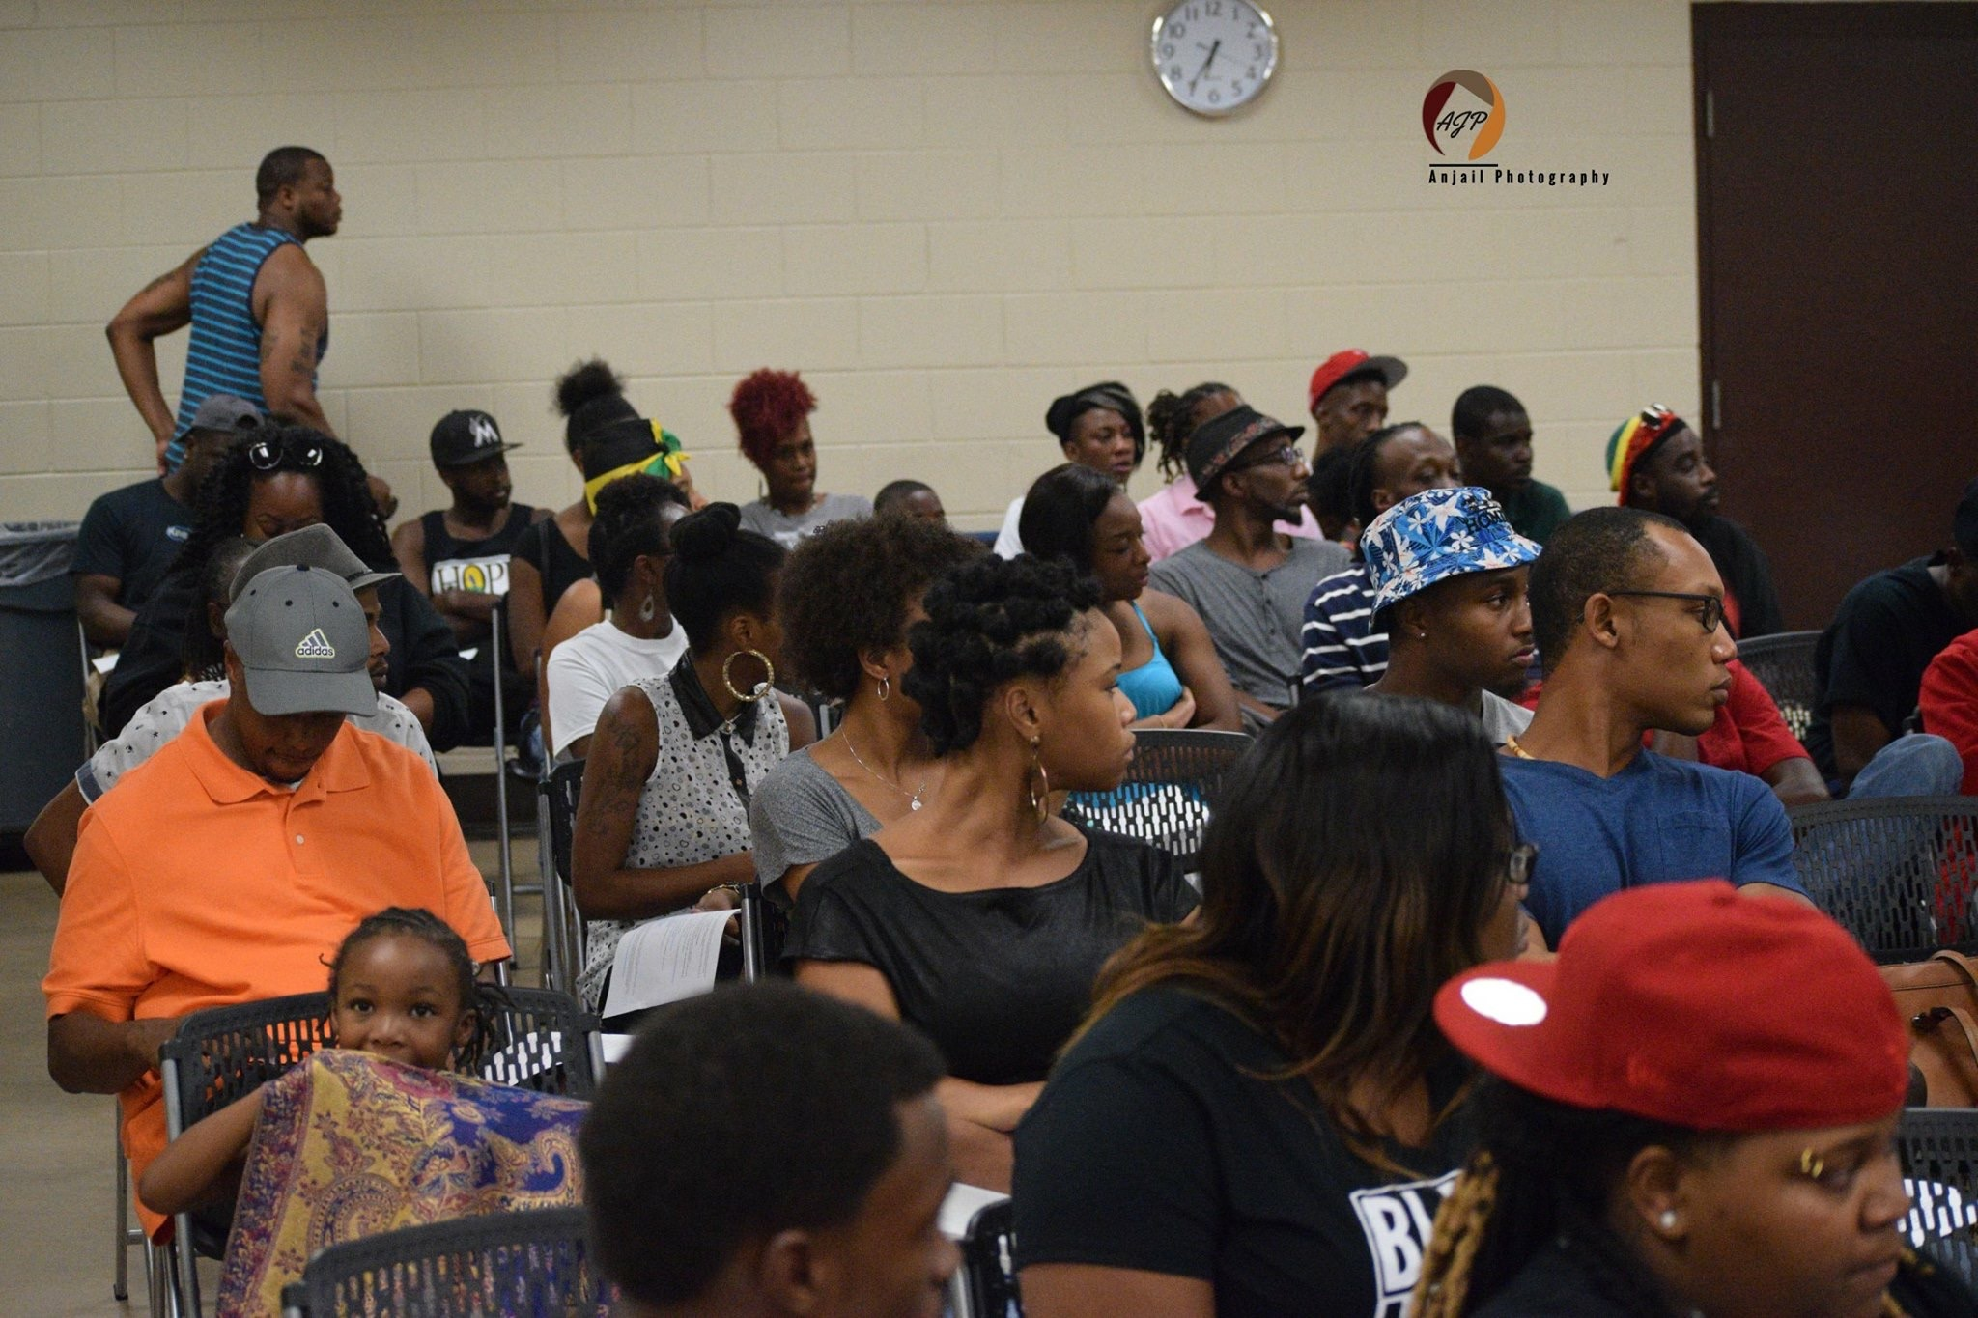
A Couple Notes About the “Let Your Voice Be Heard Community Forum”
The community forums are monthly meetings
Locations may vary to highlight new black owned businesses in various areas
We are not exclusive to one area of focus and will expand into various communities in Central Florida
We will plan our events at forums but most of the work will take place outside of the forums
Our website is now live at www.blackorlandounited.com

Slide 4
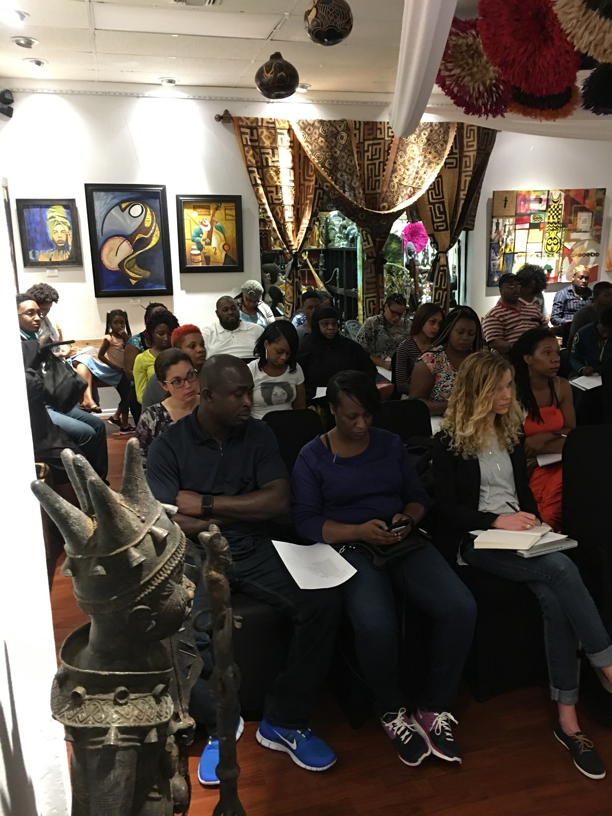
A Couple Notes About the “Let Your Voice Be Heard Community Forum”
The “recap” email will be sent out Mondays following the forum, before 11:59 pm.
We will limit talk time of each person that is not a speaker to 2 minutes max per reply. We want everyone to get a chance to talk.
If you have any ideas or things that you want to expound upon greatly, please email us the subject beforehand so we can accommodate you best.
We have started a GoFundMe “let your voice be heard comm. Forum” that will help pay for the venue spaces, newsletters, print outs, resources for community outreach, and more
  www.gofundme.com/let-your-voice-be-heard-comm-forum
The Forum is made to give everyone a chance to speak, including organizations, if you have something going on that we can be a part of, please send it to us so we can advertise it to you.

Slide 5
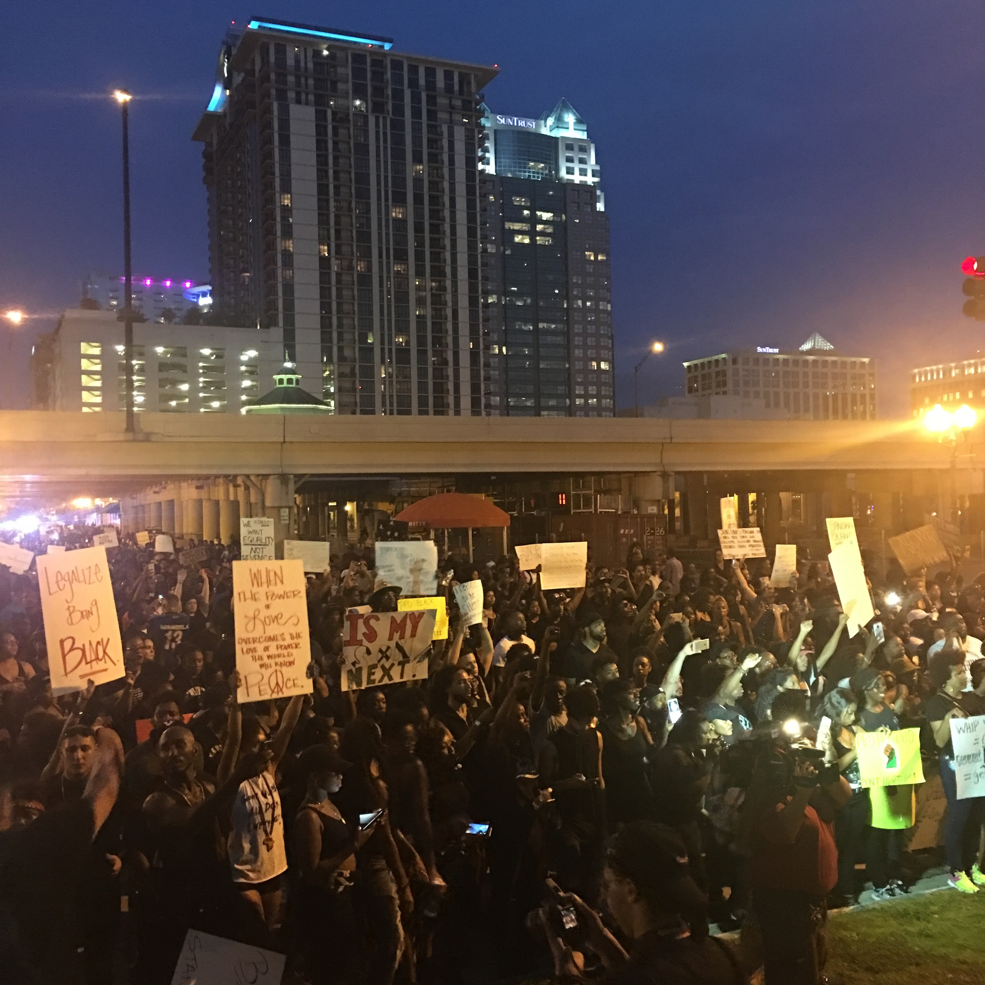
TONIGHT’S KEY TOPICS
RECAP OF LAST MEETING
SETTING SET DATES FOR YOUTH OUTREACH AND COMMUNITY OUTREACH EVENTS
PLANNING FUTURE WORKSHOPS (CRIME PREVENTION, MENTAL HEALTH,LEGAL RIGHTS, ETC)
COMMUNITY AWARENESS AND POLICING
BUILDING UP OUR OWN FUNDS
MEDIA CAMPAIGN (DIGITAL AND SOCIAL MEDIA)
CITY AND COUNTY COUNCIL MEETINGS
NEWSLETTER/ APPAREL
FLORIDA PTA INITIATIVE
OPEN FLOOR/ANNOUCEMENTS

Slide 6
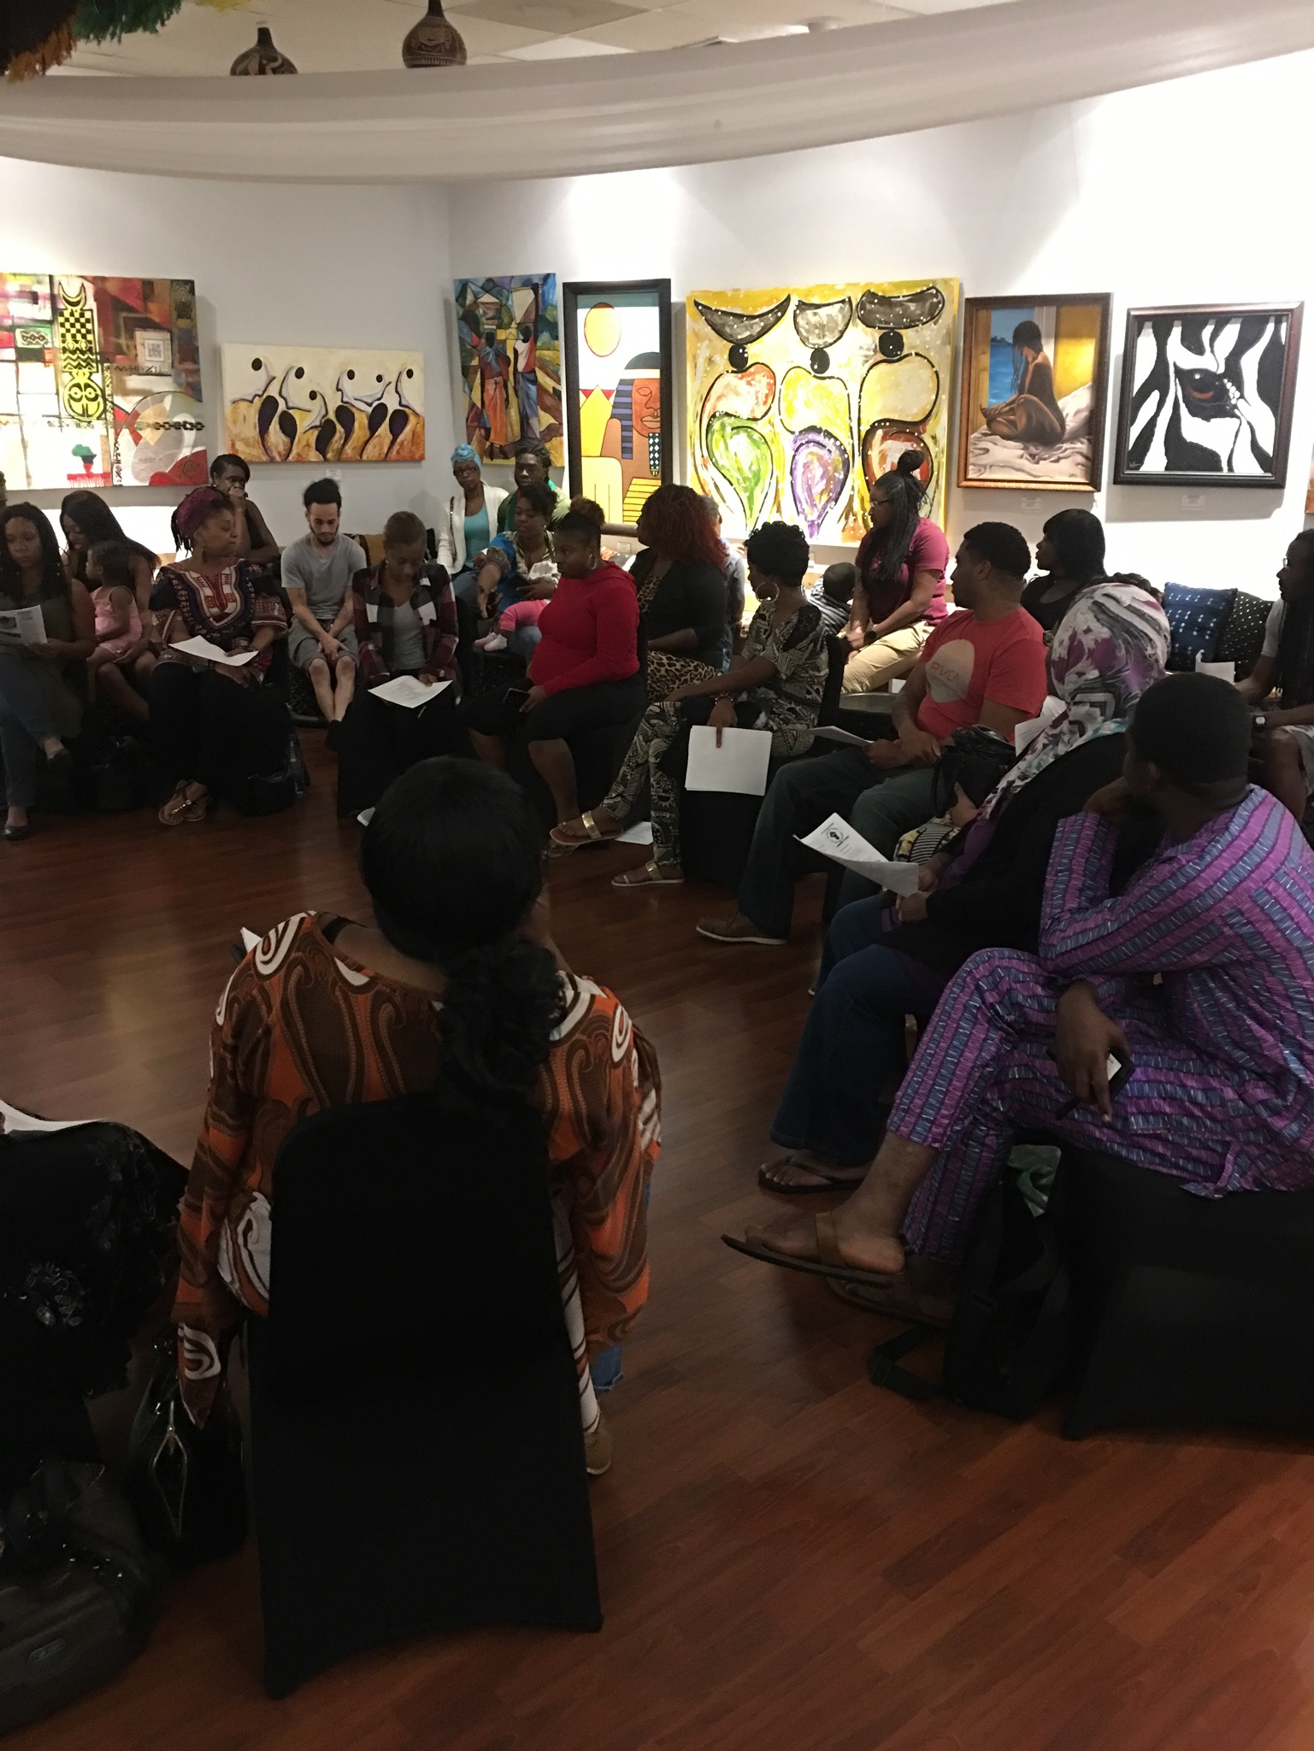
RECAP OF LAST MEETING
WWW.BLACKORLANDOUNITED.COM IS OFFICIALLY UP AND RUNNING
YOUTH AFTER SCHOOL OUTREACH HAS NOW BEEN IMPLEMETED AT JONES HIGH SCHOOL ON WEDNESDAYS AT 1:00PM, AND FRIDAYS AT ROBINSWOOD MIDDLE SCHOOL AT 3:30 PM
  MOVING FORWARD WE WILL RE ESTABLISH YOUTH OUTREACH AT EVANS HIGH SCHOOL ON MONDAYS IN THE FUTURE AND HOPE TO EXPAND TO MEADOWBROOK MIDDLE SCHOOL IN MARCH
NEXT COMMUNITY OUTREACH IS 03/11/2017
WE HAVE A CLOTHING/FOOD DRIVE FOR THE HOMELESS TAKING PLACE ON MARCH 18TH, 2017 WITH SAVING OUR DAUGHTERS
  WE CAN USE DONATIONS AND VOLUNTEERS
WE HAVE PARTNERED UP WITH THE FLORIDA PTA TO WORK ON NEW PLANS FOR SCHOOLS INCLUDING EDUCATIONAL PLANS, NEW PROGRAMS AND MORE
SETTING SET DATES FOR THE FORUMS (SUGGESTION IS EVERY LAST TUESDAY OF THE MONTH OR EVERY 3RD SATURDAY OF THE MONTH)
WE ARE WORKING ON A FACILITY TO HOUSE ALL OF OUR EVENTS PERMANENTLY AND MENTORING PROGRAMS

Slide 7
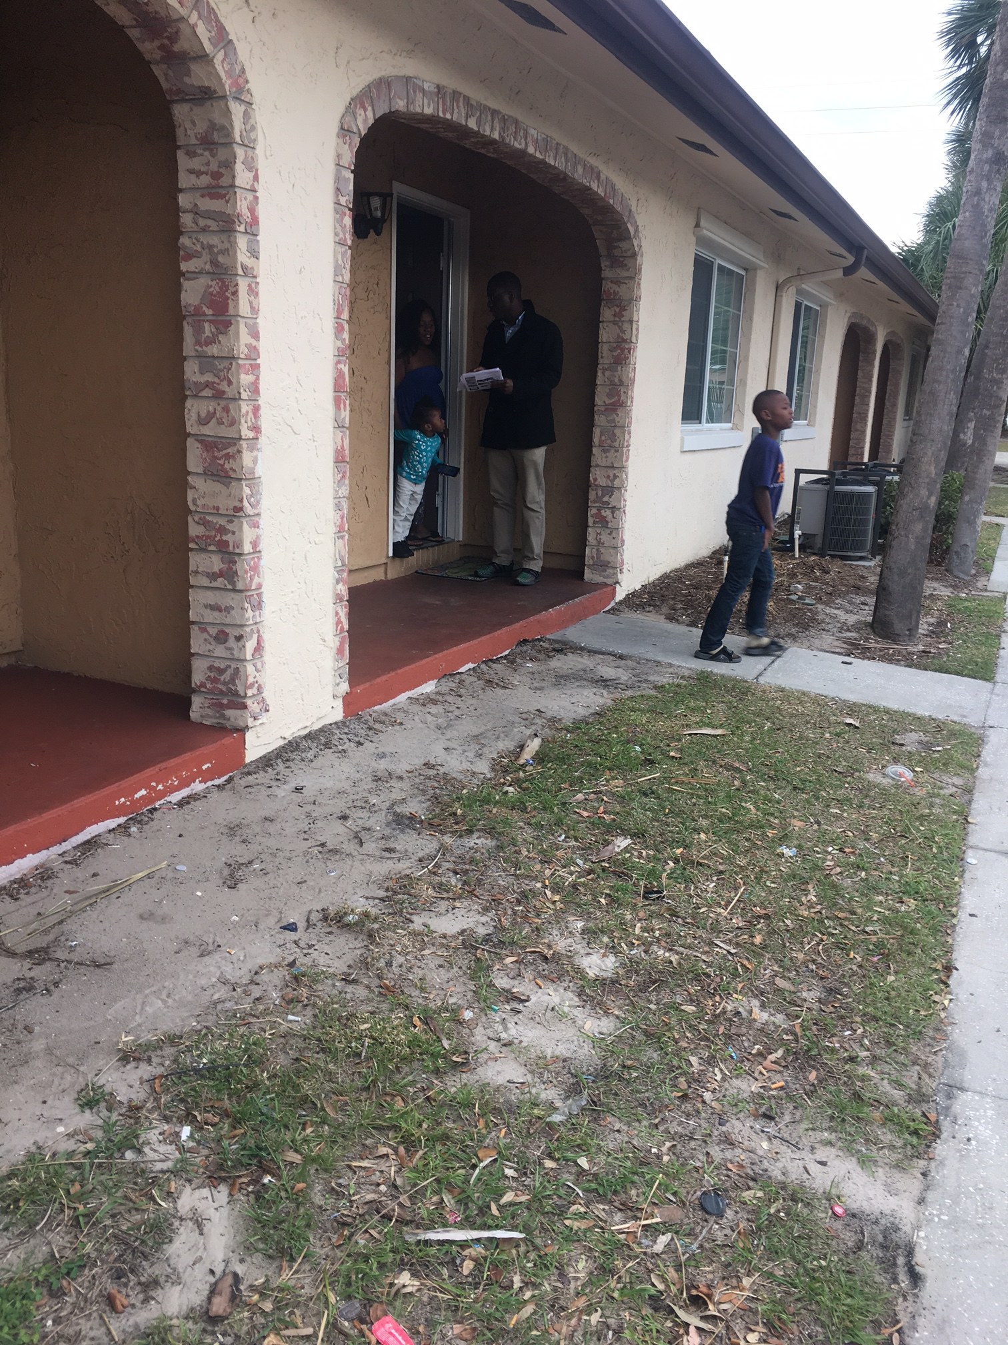
SETTING DATES FOR COMMUNITY OUTREACH FOR MONTH OF MARCH
Community outreach walks
Clothing/food drives
Community fun days

Slide 8
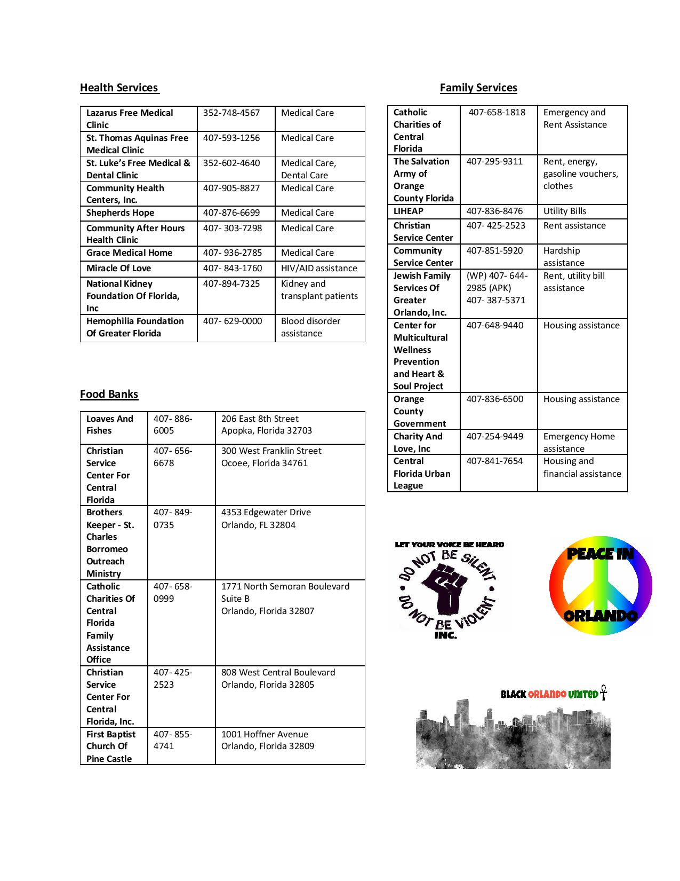
COMMUNITY OUTREACH- walk
Our first community outreach walk was 01/28/17 and next scheduled outreach walk is 03/11/17
We will meet at pine hills rd & silver star rd at 12:00pm and walk towards Hiawassee rd area targeting shopping plazas, apartment complexes, and residential homes
  The purpose of this is to engage the neighborhood, establish a presence and provide people with great resources for recreational and social services for the family and youth
  We will provide residents with information that can help benefit the home and in the future we will like to conduct surveys and find out what needs can be met with the partners we have
We have white t shirts available for everyone to wear during these type of events ($5 promotion for white shirts for wholesale price for attendants of the forum, in general shirts are $9.99 and come black and white )
In the future we will set community outreach walks for the 2nd Saturday of the month in various locations (such as pine hills, Parramore, carver shores, Ivey lane, mercy dr, etc.)

Slide 9
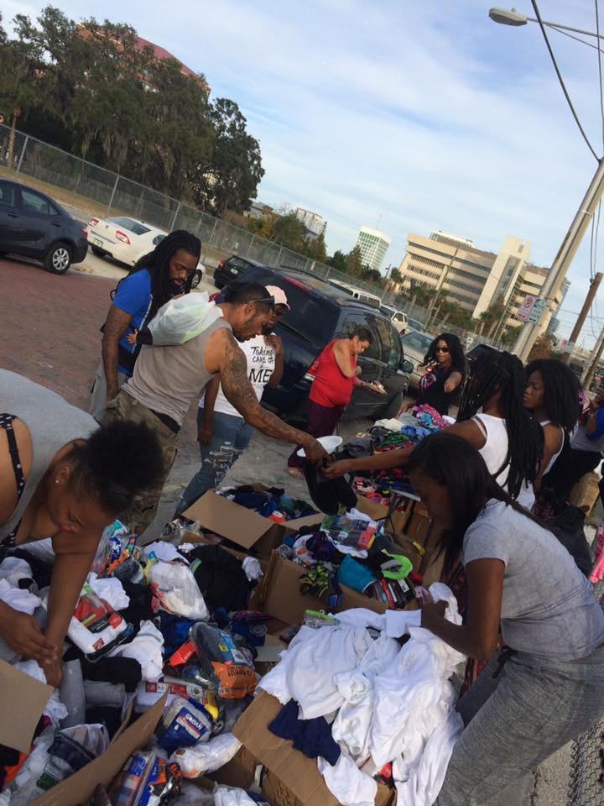
COMMUNITY OUTREACH- food/CLOTHING drive
NEXT FOOD/CLOTHING DRIVE IS SET FOR MARCH 18TH, 2017 WITH SAVING OUR DAUGHERS
  AT THESE FOOD/CLOTHING DRIVES WE WILL GIVE OUT NEW AND GENTLY USED CLOTHES TO FAMILIES IN NEED AND ALSO HAVE CANNED GOODS AND HOT MEALS PREPARED FOR ANYONE WHO WANTS
WE WILL ALSO GIVE OUT HANDOUTS THAT GIVE PEOPLE KEY INFORMATION ON GREAT PROGRAMS THAT WILL HELP (SOCIAL SERVICES, HEALTH SERVICES, YOUTH PROGRAMS, ETC)
WE WILL NEED VOLUNTEERS AND DONATIONS
FLYER COMING SOON, PLEASE SIGN UP FOR EVENT OR EMAIL US IF YOU ARE INTERESTED

Slide 10
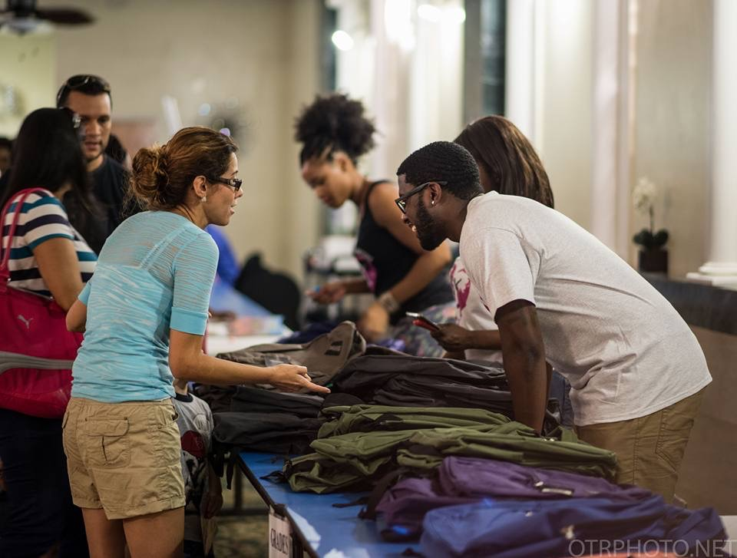
COMMUNITY OUTREACH-FUN DAYS
WE STILL NEED TO PLAN OUR FIRST OF MANY COMMUNITY FUN DAYS
  WITH VENDORS FOR AFTER-SCHOOL AND MENTORING PROGRAMS, LIFE INSURANCE, NON PROFITS, AND MORE
  BUILDS RAPPORT WITH LOCAL NEIGHBORHOODS AND INTRODUCES US TO AREA
  SHOULD DO ONE IN EACH PREDOMINANTLY AFRICAN AMERICAN COMMUNITY OF ORLANDO, FL
  CAN INVOLVE TALENT SHOWS WHERE YOUTHS SPEAK ABOUT STOPPING THE VIOLENCE AND POWER OF UNITY (WE’VE DONE ONE EARLIER THIS YEAR AT BARNETT PARK)
FIRST SUGGESTED DATE FOR 2017 IS MEMORIAL DAY WEEKEND , SATURDAY 05/27/2017
  MEMORIAL DAY WAS STARTED BY FORMER SLAVES ON 05/01/1965, AT THE SAME TIME THAT WE ARE HAVING FUN AND CELEBRATING WE ARE TEACHING OUR ROOTS
PLEASE SIGN UP IF YOU’RE INTERESTED IN HELPING COORDINATE THIS EVENT

Slide 11
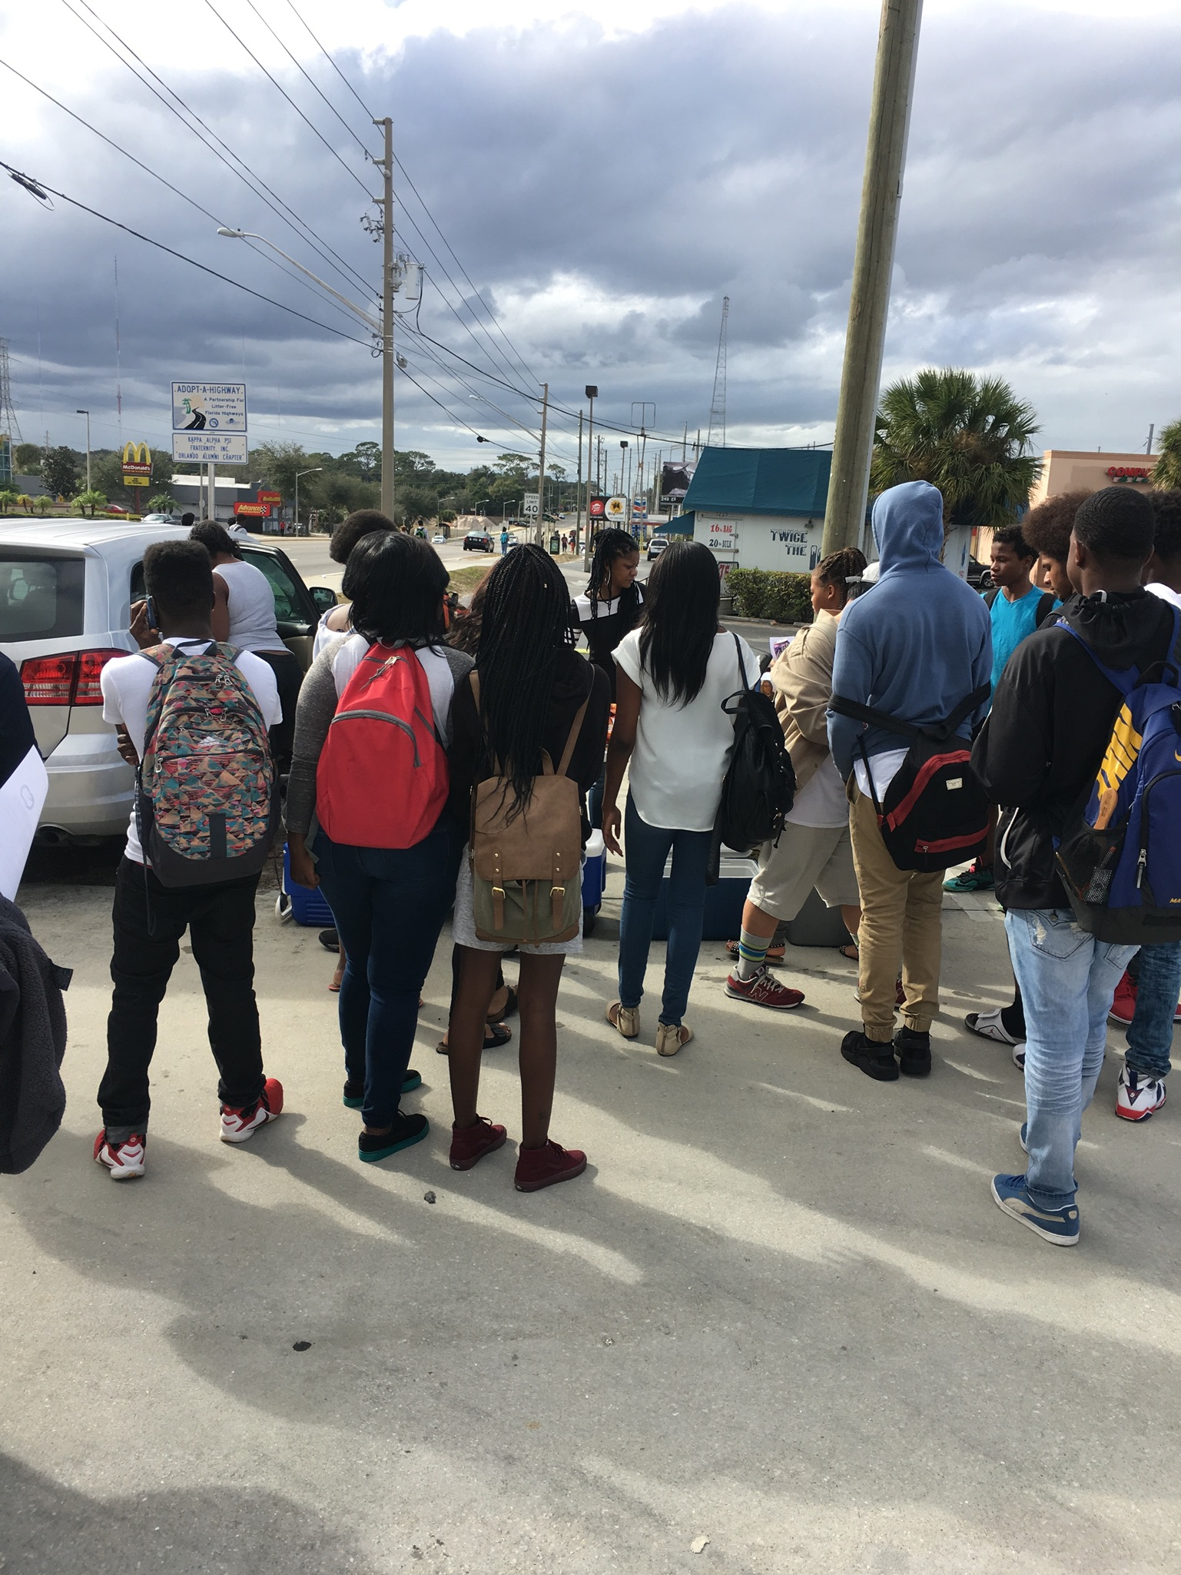
YOUTH OUTREACH
Each week we go out after school and greet the youth with chips and drinks and snacks and also provide them with information on how to get into various programs that offer community service opportunities that can be used for any purpose and even employment opportunities
  Since we have started we have got a great response for the youth and many have signed up for the opportunities we’ve presented to them
WE HAVE SET DAYS OF THE WEEK WE DO OUTREACH AND WE CAN USE VOLUNTEERS AND DONATIONS ON A CONSISTENT BASIS
  WE ARE WORKING ON SECURING SOME CORPORATE SPONSORS FOR OUR EVENTS, WE ARE PENDING TAX EXEMPT STATUS
  IF YOU WISH TO MAKE A CASH Donation YOU CAN GO TO https://www.gofundme.com/let-your-voice-be-heard-comm-forum
  PLEASE SIGN UP IF YOU’RE INTERESTED

Slide 12
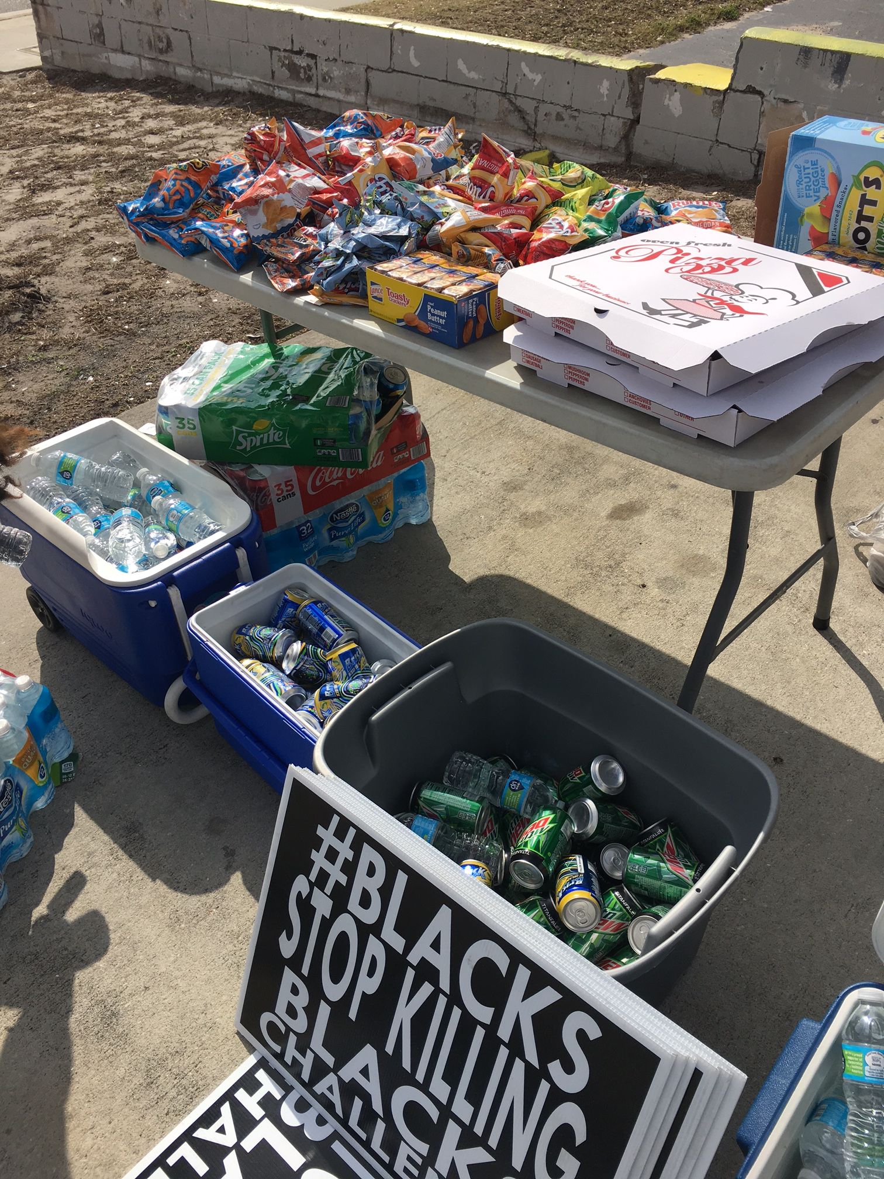
YOUTH OUTREACH
WE GO OUT ON WEDNESDAYS TO JONES HIGH SCHOOL AT 1:00PM
  MEET AT RIO GRANDE AND GORE ST
WE WILL GO OUT ON MONDAYS TO EVANS HIGH SCHOOL AT 2:00PM
  NEW MEETING LOCATION COMING
WE GO ON FRIDAYS TO ROBINSWOOD MIDDLE SCHOOL AT 3:30PM
  MEET AT TRACK SIDE ON BALBOA ST CLOSE TO SCHOOL
  IN FUTURE WE ARE ESTABLISHING A YOUTH OUTREACH AT MEADOWBROOK MIDDLE SCHOOL STARTING IN MARCH
WE ALSO SPEAK WITH THE YOUTH ABOUT THE IMPORTANCE OF STAYING IN SCHOOL AND NEGATIVE INFLUENCES
WE CAN USE DONATIONS OF CHIPS AND DRINKS AND SNACKS

Slide 13
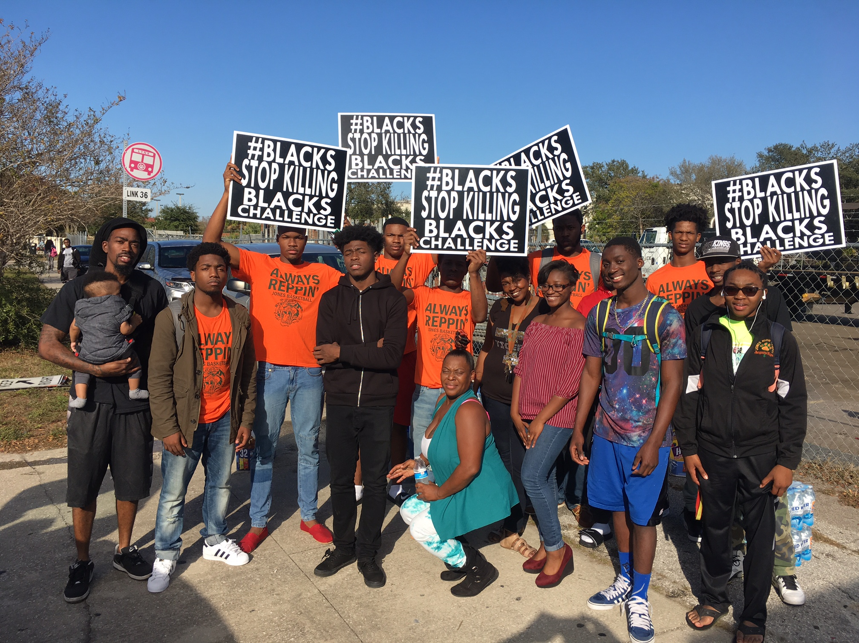
YOUTH OUTREACH- WORKSHOPS
OUR MAIN GOAL IS TO REACH THE YOUTH AND GET THE MESSAGE OF PEACE AND PROSPERITY TO THEM
WE ARE ALSO STARTING A DAYTIME WORKSHOP SERIES THAT WILL START IN MARCH
  WE WILL BE GOING TO SCHOOLS DURING THE DAY AND SETTING UP THEMED WORKSHOPS SUCH AS KNOW YOUR RIGHTS, START A BUSINESS, SMART SAVING, ETC.
  PLEASE SIGN UP IF YOU’RE INTERESTED
WE WILL ALSO HAVE A YOUTH WORKSHOP SERIES STARTING ON THE WEEKENDS, TAKING PLACE ONCE A MONTH IN WHICH WE’LL OCCUPY A YOUTH CENTER AND HAVE THEMED WORKSHOPS AND ACTIVITIES FOR THE YOUTH ALSO, STARTING IN APRIL 2017

Slide 14
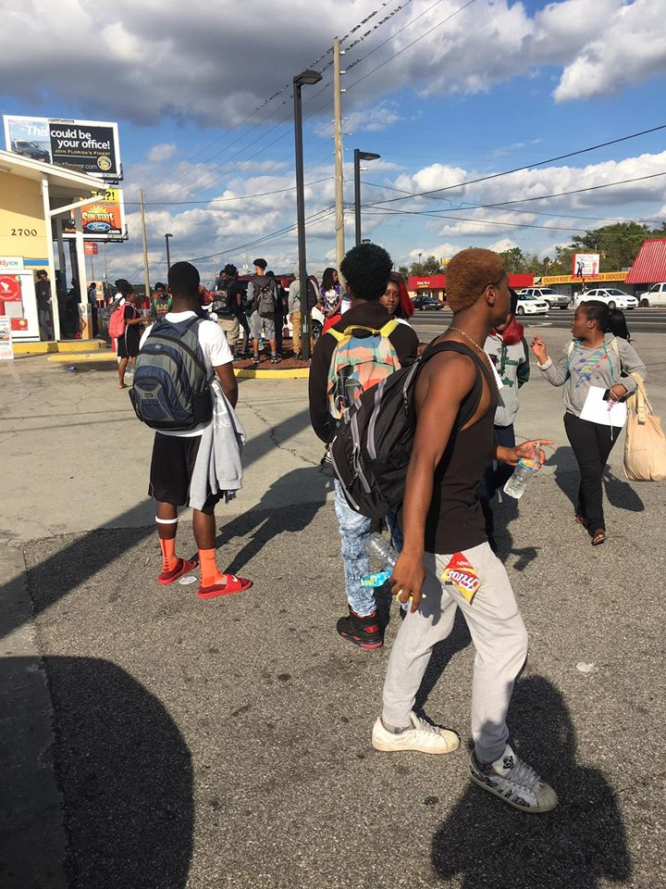
YOUTH OUTREACH
WE WILL ALSO HAVE OUTREACH ON SATURDAYS ONCE A MONTH
  PICKUP FLAG FOOTBALL, BASKETBALL, KICKBALL GAMES, ETC.
  INTERACTION WITH KIDS AND BUILD RAPPORT
  WE WILL ALSO HAVE YOUTH WORKSHOPS AND RECREATIONAL EVENTS ON UPCOMING WEEKEND (FIRST ONE DATED FOR MARCH 18TH TENTATIVELY)
WE CAN PROVIDE SNACKS AND DRINKS FOR REFRESHMENT
  WE ARE ALSO DOING A WORKSHOP FOR YOUNG MEN SOON THAT WILL FEATURE SPIRITUAL AND MENTAL GUIDANCE AND A TOUGH APPROACH FROM A MAN’S PERSPECTIV
  IN THE FUTURE WE WILL ALSO HAVE EDUCATIONAL WORKSHOPS FOR HOW TO BUILD RESUMES, DRESS PROFESSIONALLY, RESPECT PARENTS, AND JOB FAIRS.

Slide 15
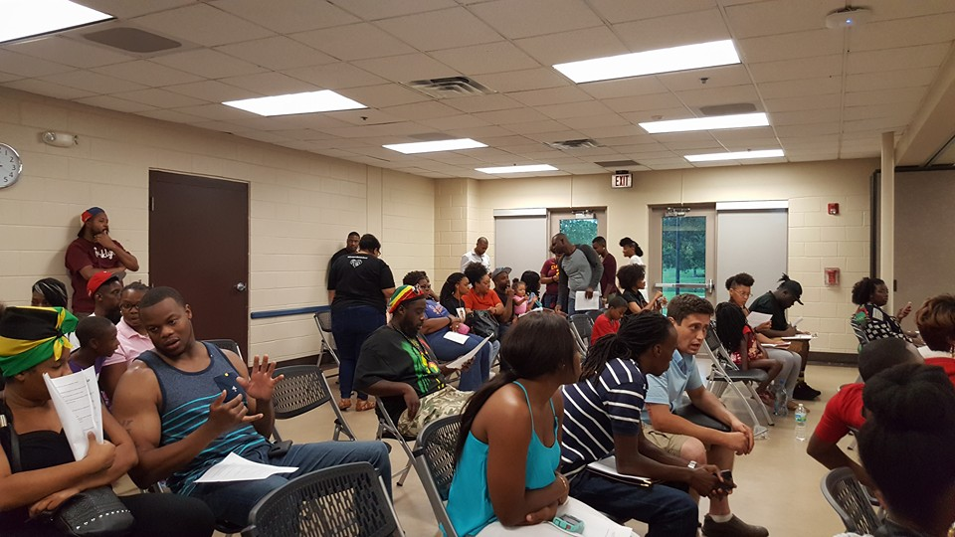
PLANNING FUTURE WORKSHOPS
WE HAVE HOSTED AND CO-HOSTED LEGAL RIGHTS, GRANT-WRITING, MENTAL HEALTH AND OTHER VARIOUS WORKSHOPS IN THE PAST
IN THE FUTURE WE PLAN TO WORK ON WORKSHOPS FOR AREAS AND SUBJECTS SUCH AS CREDIT REPAIR, FIRST TIME HOME BUYER’S PROGRAM, FINANCIAL INVESTMENT, ANCESTRY RESEARCH, SPIRITUAL, AND MANY MORE DIFFERENT VERSIONS OF WORKSHOPS
WE WILL WORK WITH PROFESSIONALS WHO ARE REFERRED TO US, AFTER WE HAVE RESEARCHED AND ESTABLISHED THAT EACH PROFESSIONAL IS BEST SUITED TO FACILIATE THESE WORKSHOPS
WE ALSO HAVE A YOUTH SERIES OF WORKSHOPS THAT WILL FOCUS ON AREAS SUCH AS ANTI-BULLYING, SELF ESTEEM, PEER PRESSURE, SOCIAL MEDIA, AND MORE.
WORKSHOPS WILL TAKE PLACE ON THE LAST FRIDAY OF EACH MONTH FOR ADULTS AND ON THE LAST SATURDAY OF EACH MONTH FOR THE YOUTH

Slide 16
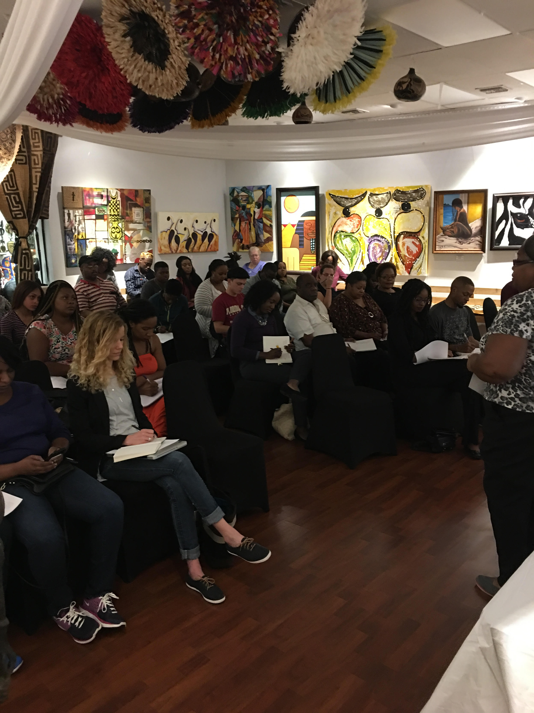
PLANNING FUTURE WORKSHOPS
WE WILL WORK ON EACH WORKSHOP IN A GROUP WHEN WORKSHOP DATES ARE APPROACHING
WORKSHOPS WILL BE A MONTH APART, BUT THE FIRST WORKSHOP WILL TAKE PLACE IN APRIL SO WE CAN ADEQUATELY PLAN IT TOGETHER
WE HOPE TO PROMOTE EACH EVENT THROUGH SOCIAL MEDIA, PHYSICAL PRINT AND WORD OF MOUTH
PLEASE SIGN UP IF YOU’RE INTERESTED

Slide 17
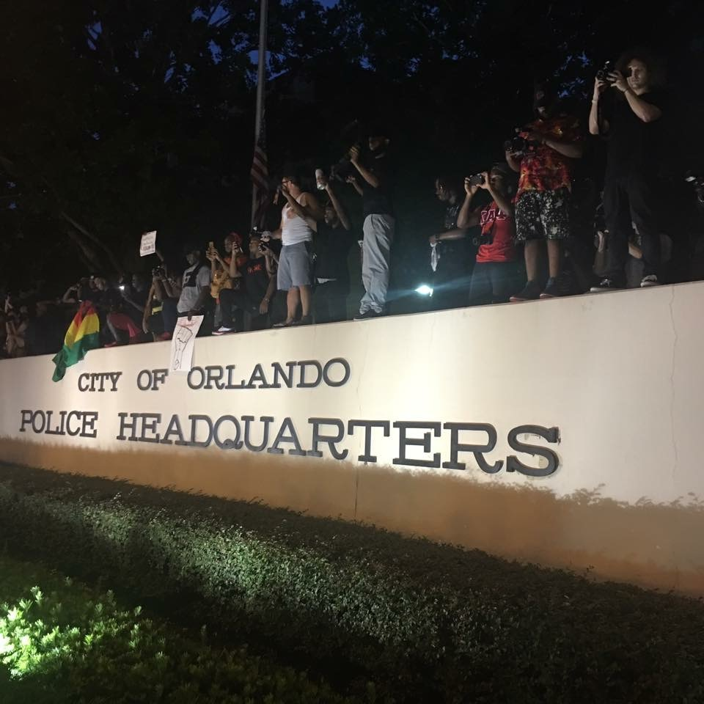
COMMUNITY POLICING- PEACE WALK
WE HAVE ATTEMPTED IN THE PAST TO SET UP A NEIGHBORHOOD PATROL, OCSO HAS INFORMED US THAT IN ORDER TO DO AN OFFICIAL NEIGHBORHOOD PATROL WE WOULD TO BASE EACH ONE ON THE ADDRESS LISTED ON OUR I.D.
IN ORDER TO REMAIN MOBILE, WE CAN HAVE PRESCENCES IN THE NEIGHBORHOODS BUT CANNOT BE AN OFFICIAL NEIGHBORHOOD WATCH
WE CAN REFER MEMBERS OF EACH AREA ON THE STEPS THEY NEED TO TAKE TO BECOME NEIGHBORHOOD WATCH
WE CAN CONDUCT PEACE WALKS THROUGH NEIGHBORHOODS ONCE A MONTH AT NIGHT TO ENGAGE RESIDENTS AND SHOW OUR PRESENCE

Slide 18
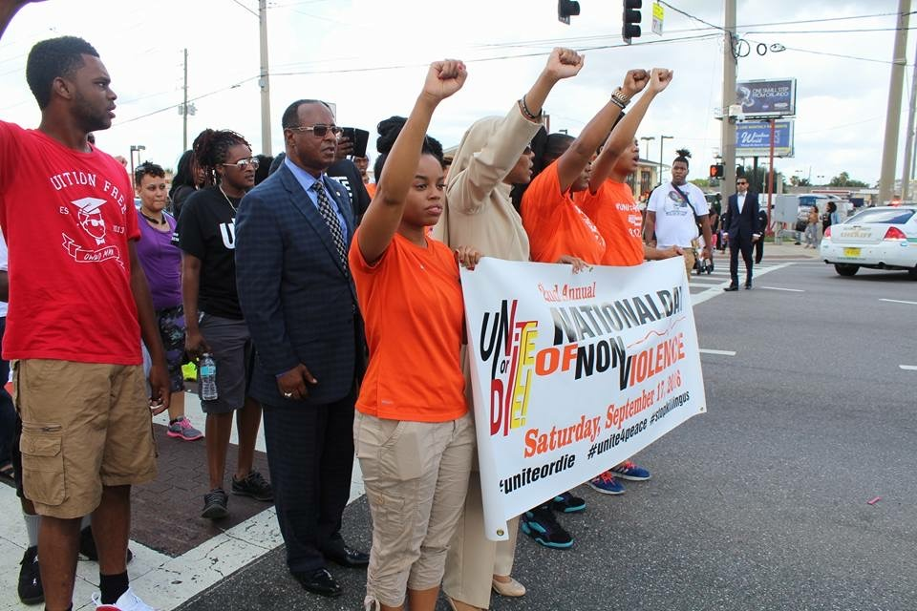
COMMUNITY POLICING- PEACE WALK
WE WILL SERVE AS A PRESENCE IN THE NEIGHBORHOOD BUT WILL NOT BE INTERACTING WITH CRIME OF ANY FORM
WE WILL CONDUCT PEACE WALKS THROUGH NEIGHBORHOODS IN WHICH WE SHOW WE CARE AND ARE AWARE, AND ALSO REACH OUT TO RESIDENTS TO FIND OUT WHAT NEEDS THEY MAY HAVE
  SURVERYS AND HANDOUTS CAN BE IMPLEMNTED ALSO
  THESE WILL BE DONE 6:30PM AT NIGHT, THROUGH ONE NEIGHBORHOOD, ONCE A MONTH
WE CAN BE A VISUAL PRESENCE THAT CAN DETER CRIME AND ALSO LAW ENFORCEMENT ABUSE
TARGET AREAS ARE:
  PINE HILLS, CARVER SHORES, IVEY LANE, MERCY DRIVE, SEMORAN, APOPKA, PARRAMORE, AND ANY SURRONDING AREA
FIRST PEACE WALK IS DATED FOR 03/25/2017 AT 6:30 PM ON PINE HILLS RD AND SILVER STAR RD HEADING DOWN SILVER STAR TOWARDS HIAWASSEE RD
  PLEASE SIGN UP IF YOU’RE INTERESTED

Slide 19

Building up our own funds
WE CAN HELP EMPOWER THE RESIDENTS AND YOUTH OF ORLANDO, FL BY PROMOTING PROGRAMS ALREADY IN PLACE (MENTORING, FINANCIAL, EDUCATIONAL, ASSISTANCE, ETC)
PROGRAM SHEETS ARE BEING DISTRIBUTED THROUGH NEIGHBORHOODS
WORKSHOPS FOR FUTURE (GRANT WRITING, CONCEALED WEAPON PERMIT, OCOEE MASSACRE, KNOW YOUR RIGHTS, ETC)
  WORKSHOPS WILL HELP EMPOWER PEOPLE THROUGH KNOWLEDGE AND INFORMATION
  FINANCIAL WORKSHOPS IN THE FUTURE CAN BE FIRST –TIME HOME BUYER’S PROGRAM, CREDIT REPAIR, DAY TRADING TIPS, ETC

Slide 20
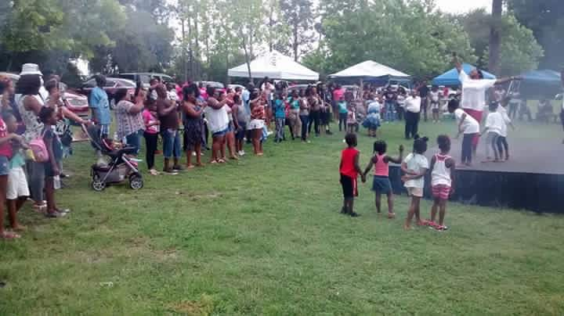
Building up our own funds
We also can start a community fund, if each person donated $1-$5 per month we can keep the budget public and plan events together with funds
Funds can go towards investing into one business each month in central Florida in the form of a community grant
Other group economic strategies can be used
Any suggestions?

Slide 21
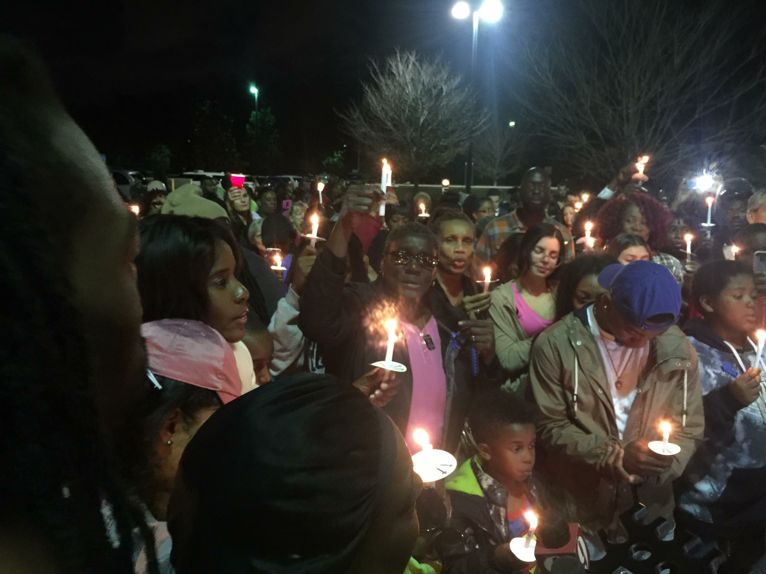
MEDIA CAMPAIGN
WE WILL BE STARTING A DOCUMENTARY SERIES IN WHICH WE RECORD PEOPLE’S TRIAL AND TRIBULATIONS IN ORLANDO, FL
CAN VARY FROM SOMEONE WHO HAS EXPERIENCED A TRAUMATIC EXPERIENCE TO A PERSON WHO HAS A STRUGGLE OR EXPERIENCE THEY WOULD LIKE TO SHARE
THIS WILL HELP ADD A FACE TO SOME OF THE STORIES WE SEE IN MEDIA AND HUMANIZE THE VICTIMS THAT ARE REPRESENTED AS JUST NUMBERS AND STATISTICS
THIS WILL BE FEATURED ON YOUTUBE AND VARIOUS OTHER OUTLETS
FIRST PUBLICATION TO BEGIN APRIL
PLEASE SIGN UP IF YOU’RE INTERESTED

Slide 22
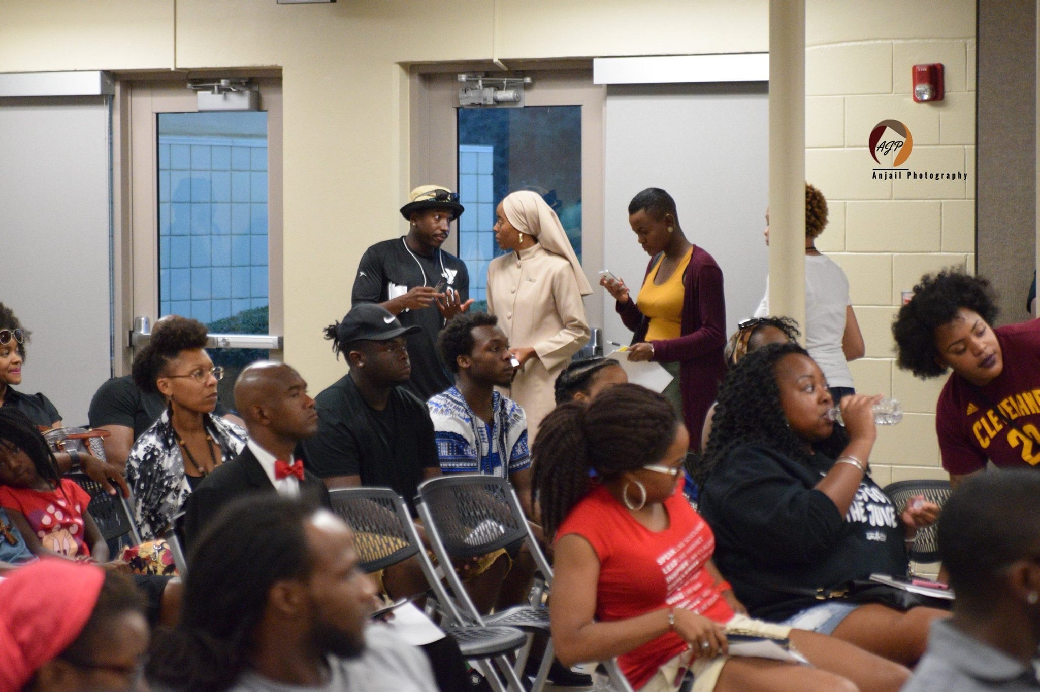
CITY COUNCIL AND ORANGE COUNTY MEETINGS
We can meet at Forums and among ourselves but unless we propose our ideas to the elected officials of the local government, changes will not be made
If we don’t attend meetings we can look up our local officials online and write them with our concerns, there is power in keeping records of our requests.
We have to do research on each topic we suggest to have changed
We can attend the upcoming meeting on February 13th and February 27th at 9:30 am
Send ideas to info@blackorlandounited.com

Slide 23
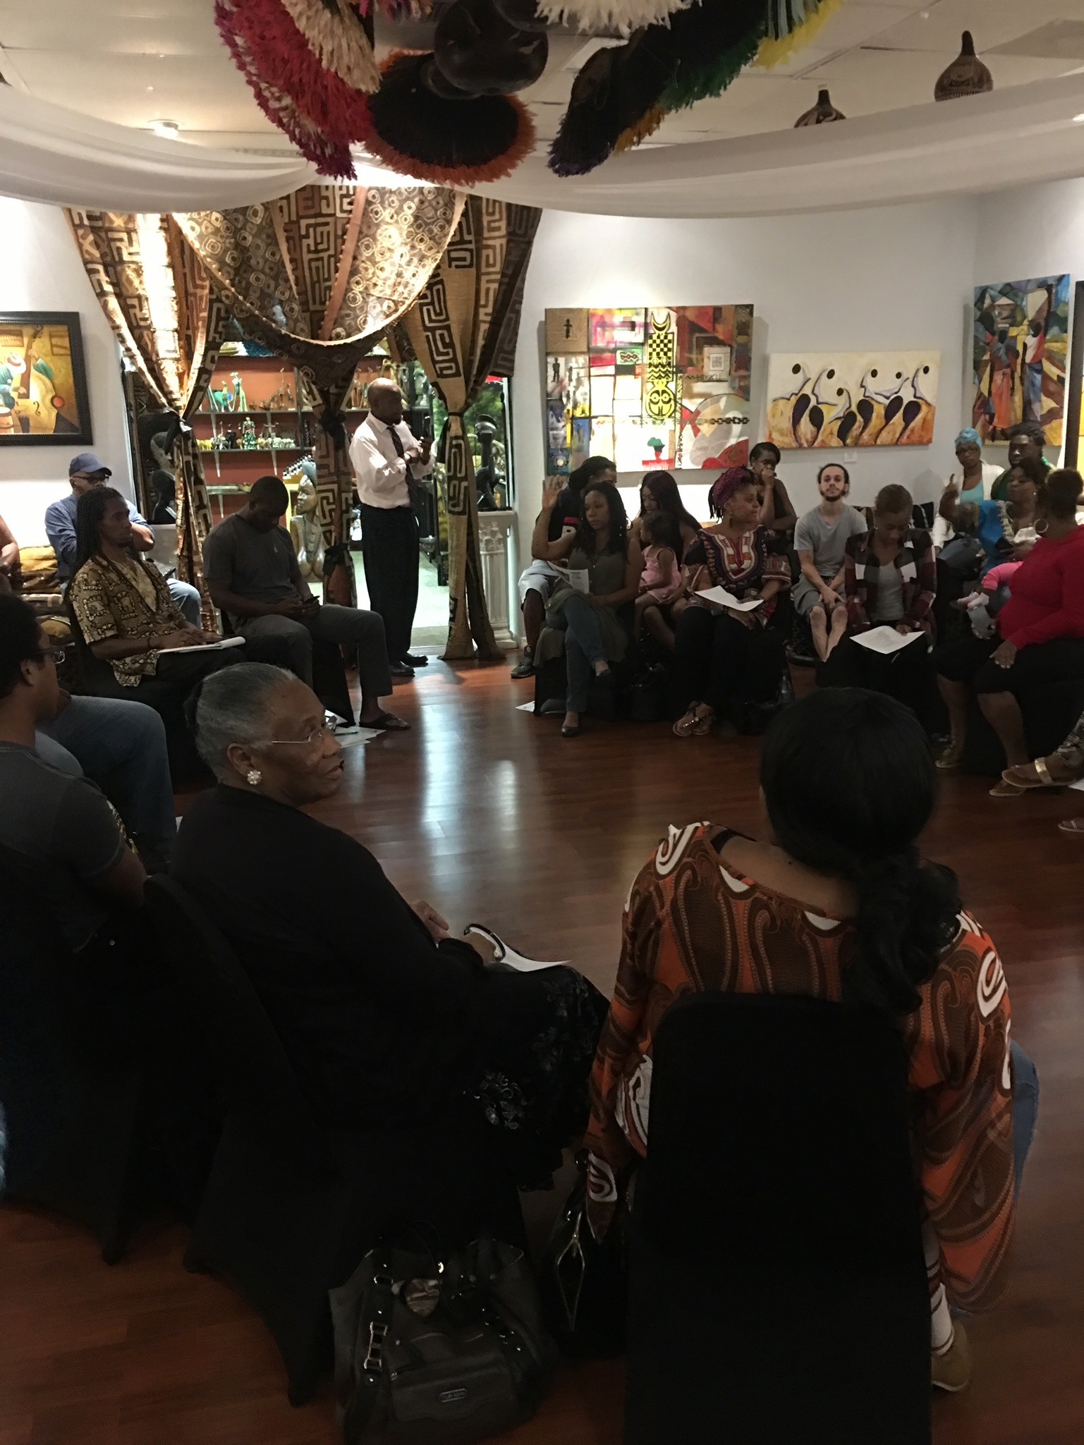
CITY COUNCIL AND ORANGE COUNTY MEETINGS
UPCOMING AGENDA FOR ORLANDO CITY COUNCIL MEETING:
  http://www.cityoforlando.net/cityclerk/city-council-calendar/
  IN ORDER TO APPEAR BEFORE COUNCIL YOU MUST FILL OUT FORM AT CITY HALL
UPCOMING AGENDA FOR ORANGE COUNTY BOARD OF COUNTY COMMISSIONERS MEETING :
  http://www.orangecountyfl.net/BoardofCommissioners/eAgenda.aspx#.WGVTxPkrK00
  IN ORDER TO APPEAR BEFORE COUNCIL :
  Http://www.orangecountyfl.net/BoardofCommissioners/BoardAppearanceRequest.aspx#.WGVTn_krK00

Slide 24
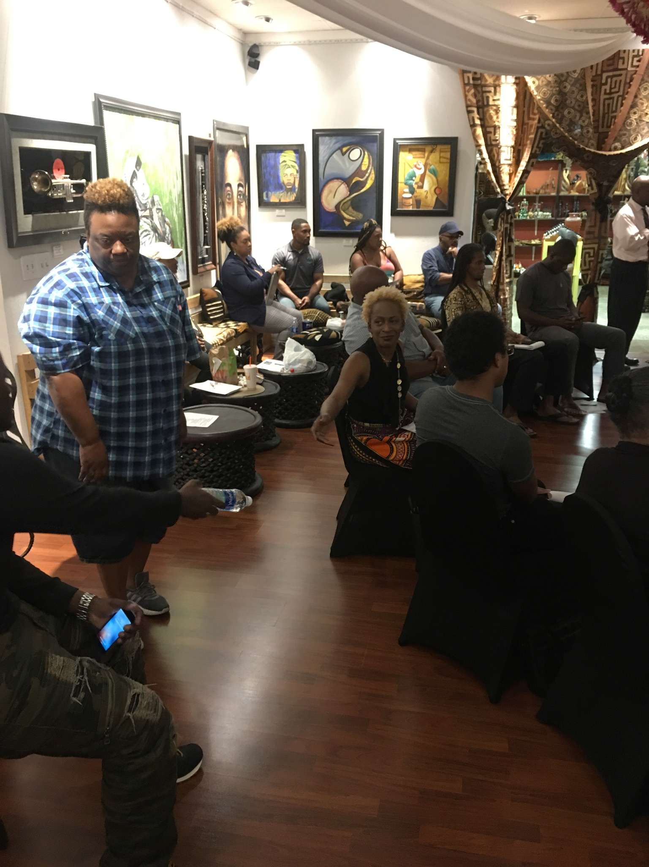
Suggestions made at the last forum for the City AND COUNTY Council Meetings
    Changes of the hiring process for the education system, having the employment become more diverse.
    Changes made to the expungement system for misdemeanor and felony charges and convictions, in order to reduce the waiting time, and expand the range of what crimes can be expunged.
    Easier versions of the budget released, online preferably.
    More contracts be pushed to African American and other ethnic groups for construction, security, and real estate in Orange County.
    More small business grants for residents of Orange County.
    Better housing for single mothers and kids, and to also include single father, and men more in the housing opportunities for residents.

Slide 25
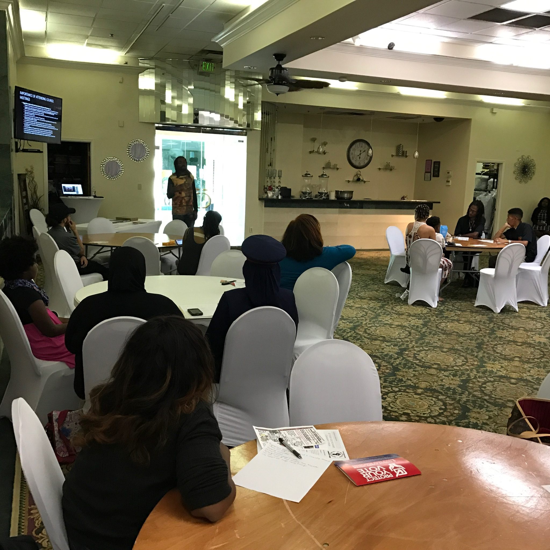
Suggestions made at the last forum for the City AND COUNTY Council Meetings
    Law enforcement releases toxicology of each police officer involved in a shooting.
    The process for all police officer involved shooting be made to have mandatory unpaid leave.
    If an officer is out on leave for a shooting, they are not allowed to work any jobs that may require a gun (security, etc.).
    To have the definition of “Imminent threat” reviewed for the provision of lethal force.
    More free programs for trade school, technical school, and learning second languages.
    More agriculture training provided through the school system for young students
    More opportunities created for high school students to have a pipeline directly to trade school
PLEASE SEND ALL NEW DETAILED SUGGESTONS TO INFO@BLACKORLANDOUNITED.COM

Slide 26
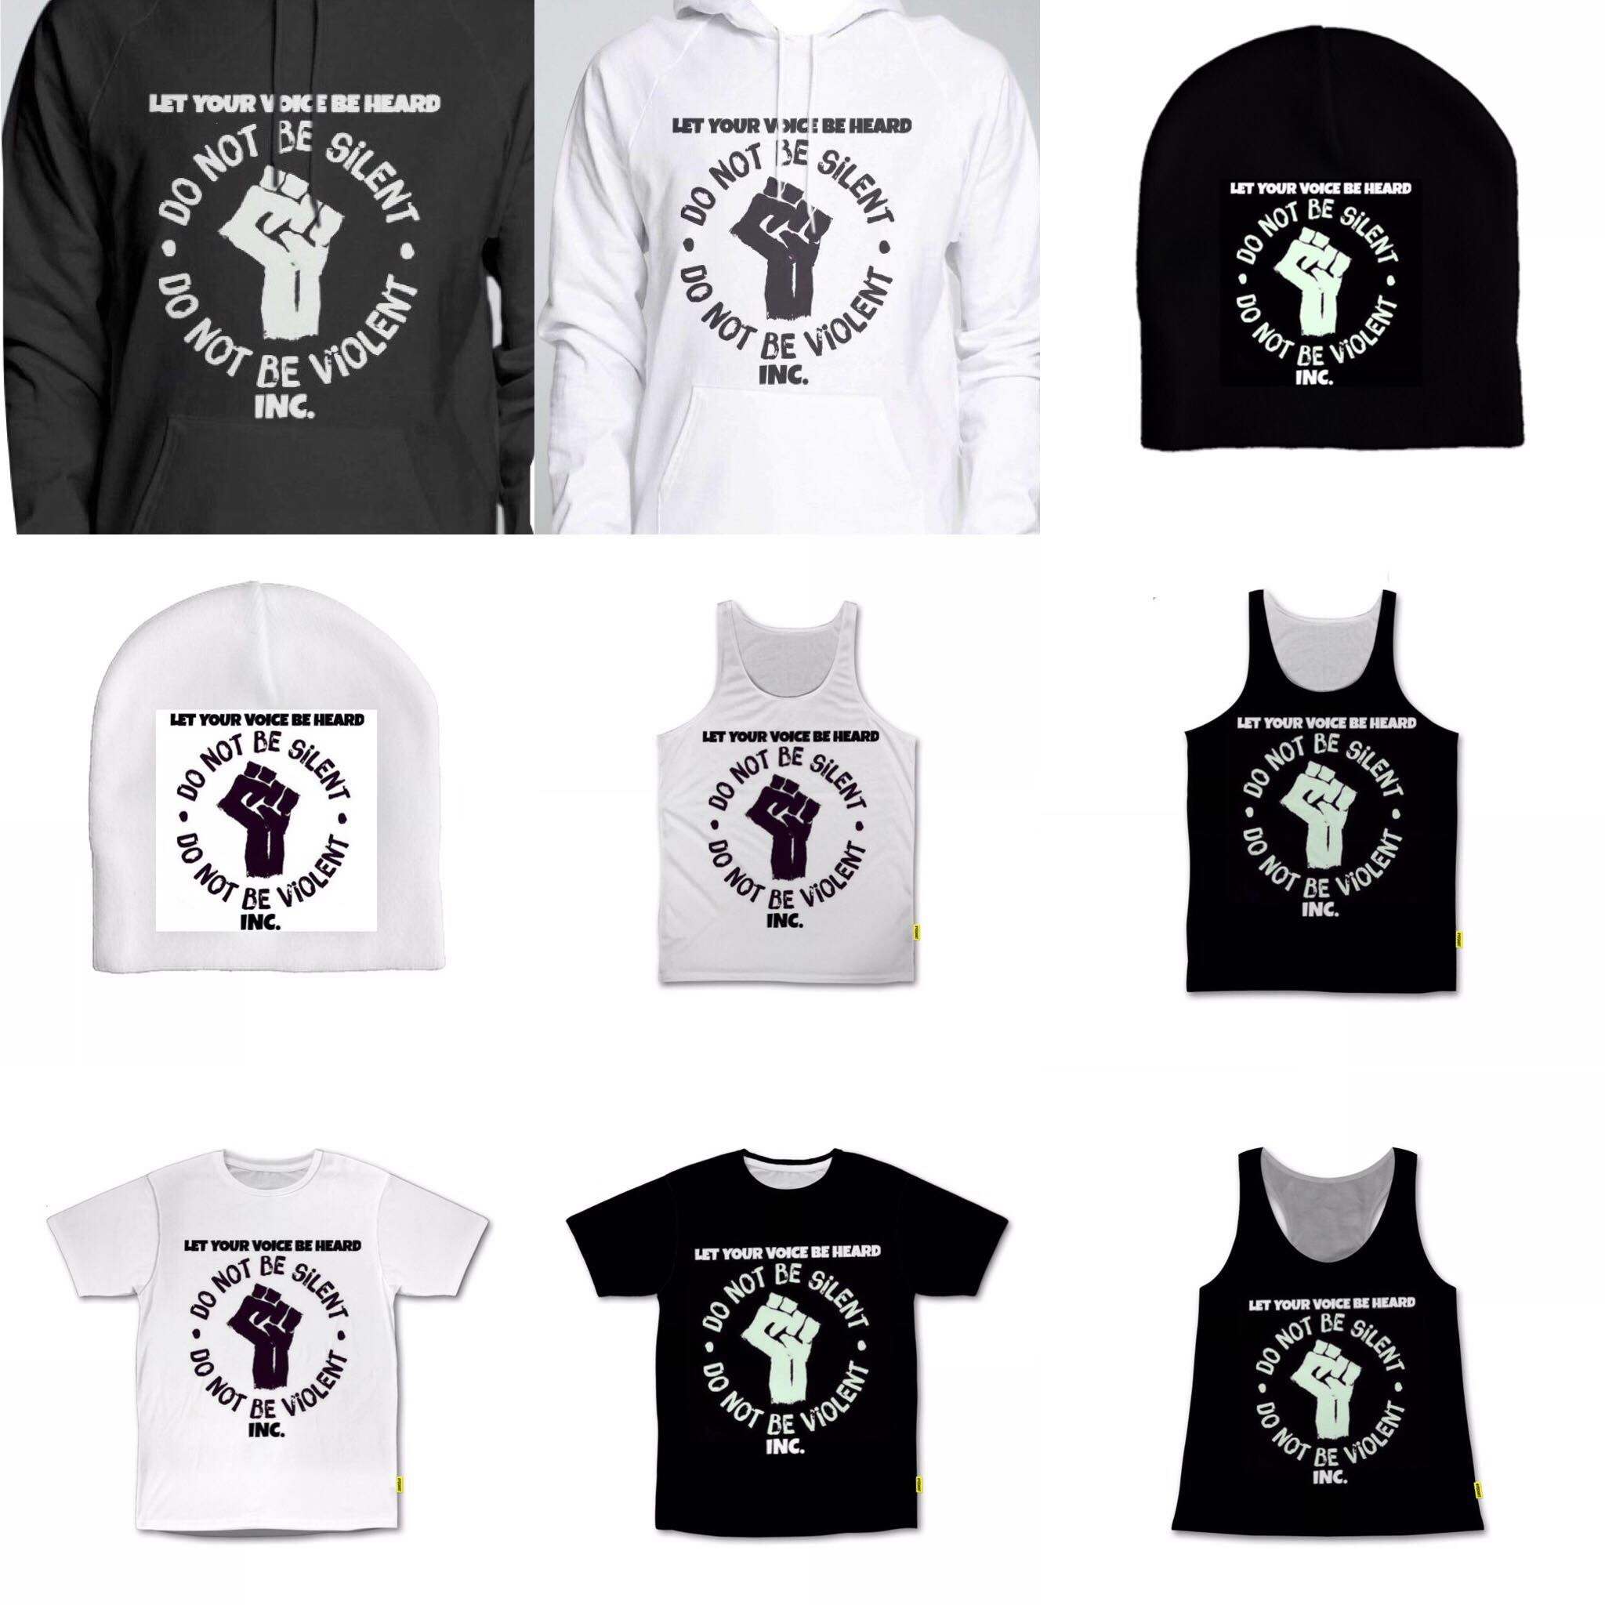
APPAREL FOR SALE
All proceeds of APPAREL SALES go towards costs for community efforts like afterschool youth outreach, workshops, community walks, fun days, food and drinks for the youth, trips, and more. APPAREL will be pre-ordered and delivered brand new.
www.blackorlandounited.com/store

Slide 27
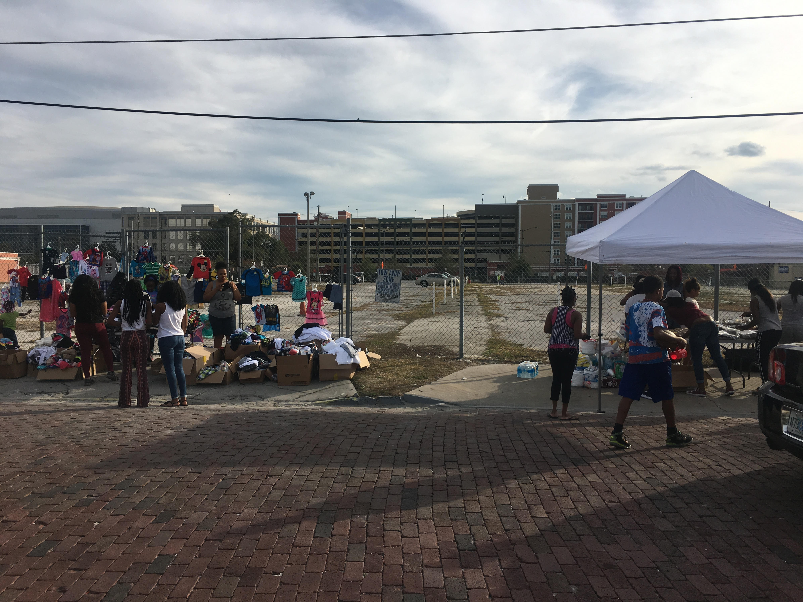

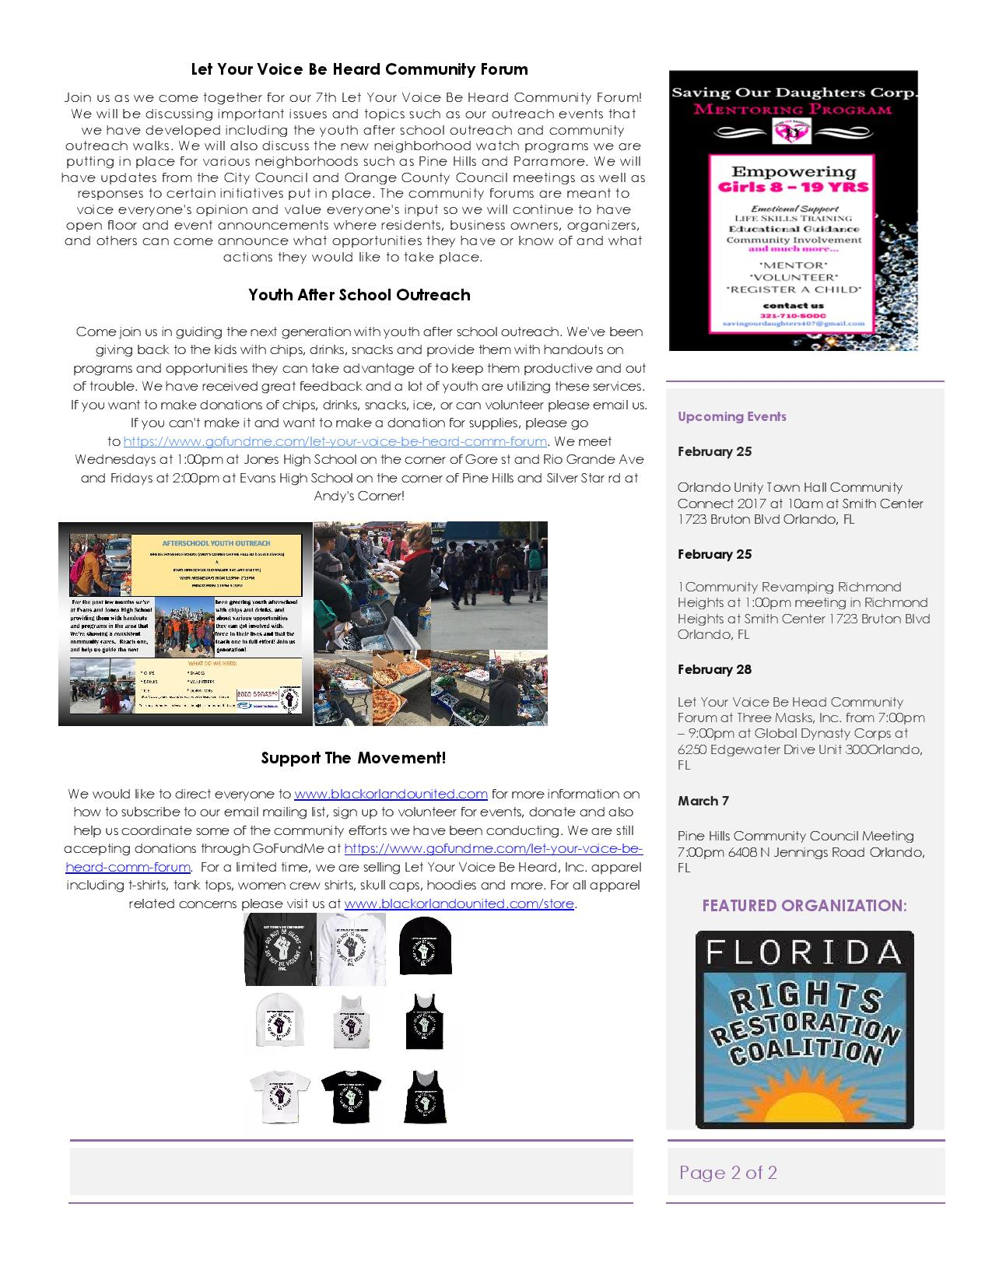
LET YOUR VOICE BE HEARD COMMUNITY FORUM NEWSLETTER

Slide 28
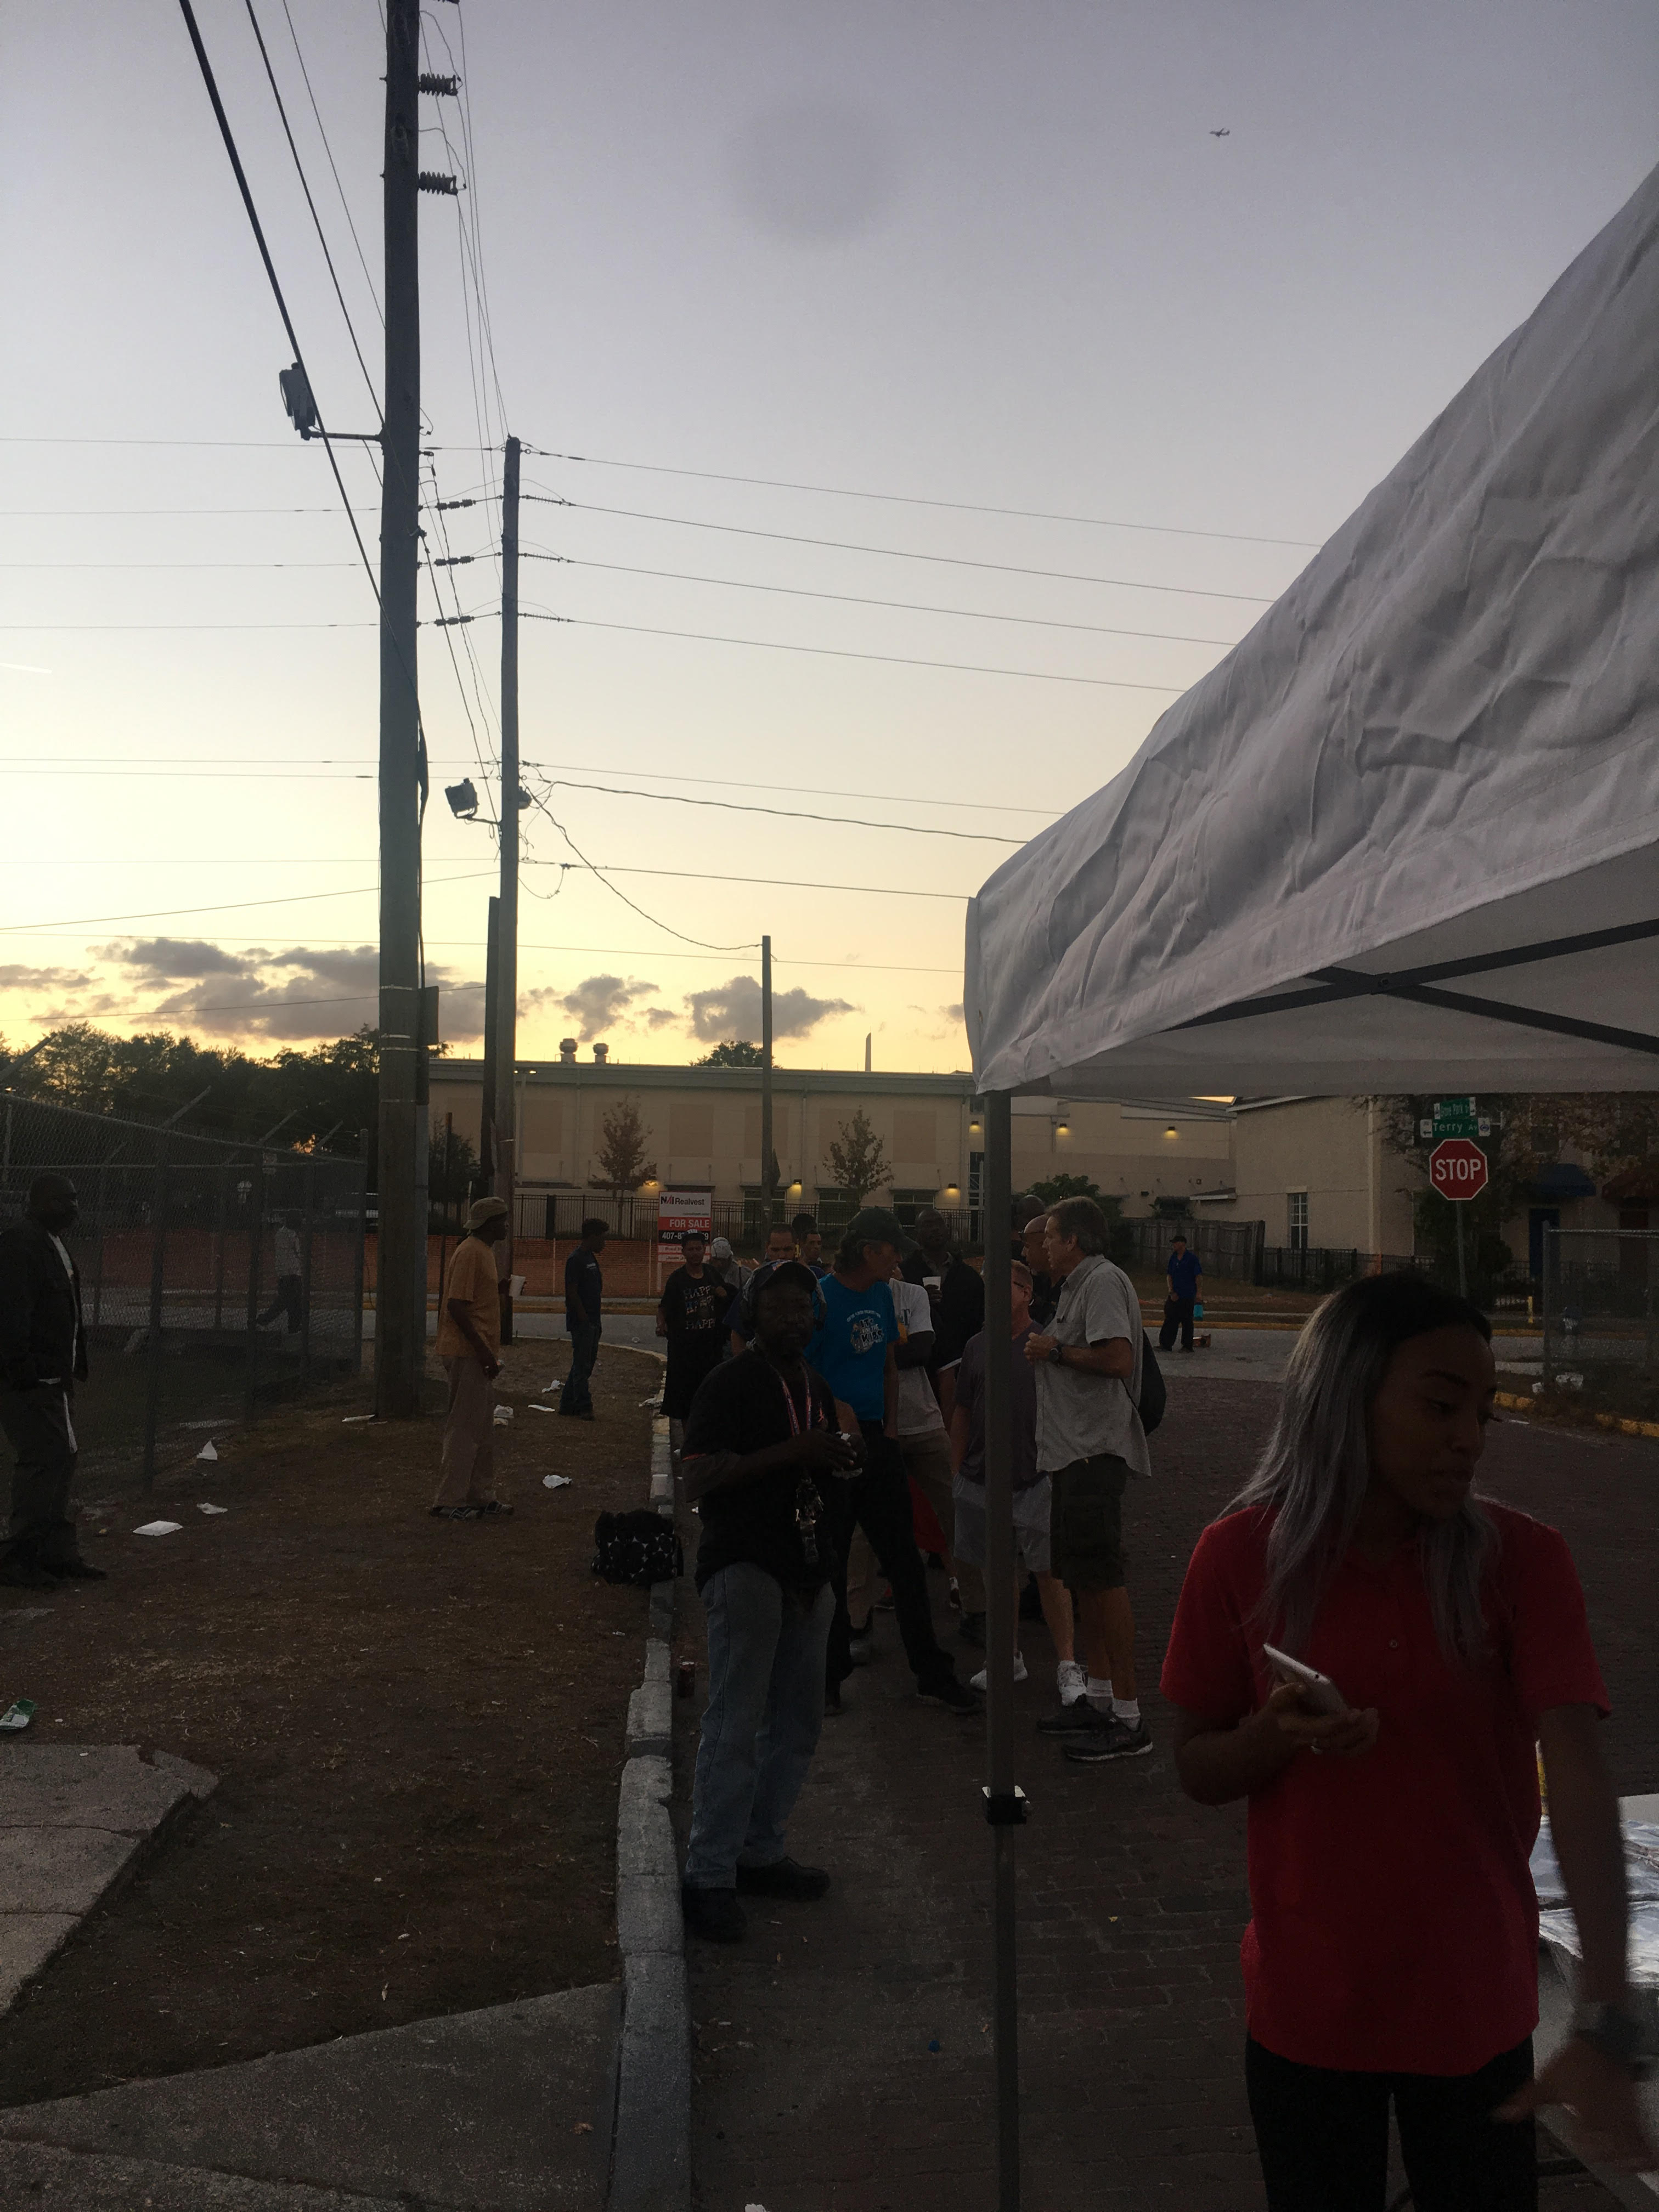
LET YOUR VOICE BE HEARD COMMUNITY FORUM NEWSLETTER
WE WILL ACCEPT CONTRIBUTIONS TO THE NEWSLETTER
WE ALSO WANT TO ADVERTISE 3 MENTORING/YOUTH PROGRAMS PER MONTH AND 3 COMMUNITY EVENTS
WE WILL DISTRIBUTE PHYSICALLY, BUT WE CAN ALSO DISTRIBUTE ELECTRONICALLY
PLEASE SEND ANY SUGGESTIONS TO INFO@BLACKORLANDOUNITED.COM

Slide 29
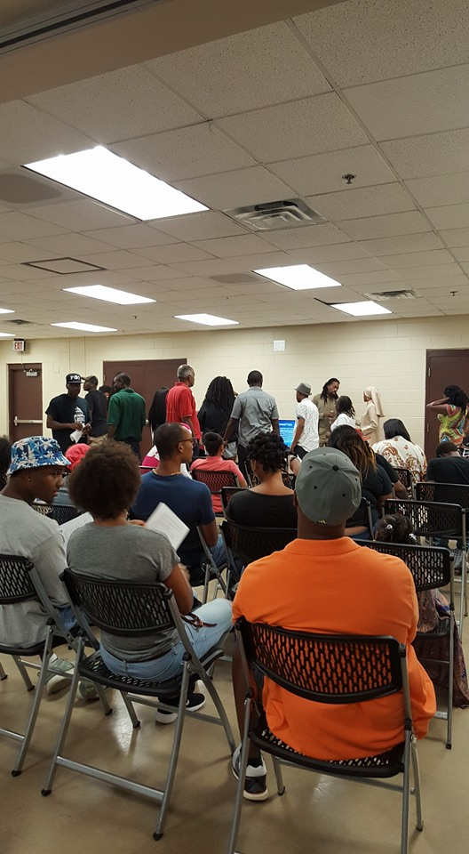
Open floor/ announcements
Open floor

