Slide 1
LET YOUR VOICE BE HEARD COMMUNITY FORUM
12/29/2016

Slide 2
The 4th day of kwanzaa ujamaa

Slide 3
LET YOUR VOICE BE HEARD COMMUNITY FORUM
ONE OF THE MAIN GOALS OF OUR COMMUNITY FORUM IS TO BUILD CONNECTIONS WITHIN THE CITY
PLEASE INTRODUCE YOURSELVES
THERE IS A SIGN IN SHEET AT THE FRONT OF THE ROOM IF YOU WISH TO SPEAK

Slide 4
A Couple Notes About the “Let Your Voice Be Heard Community Forum”
They will take place at “THREE MAKS INC” located AT 1023 W. COLONIAL DR. ORLANDO, FL 32804 , LOCATED CLOSE TO ORANGE BLOSSOM TRAIL AND W. COLONIAL DR.
A “recap” email will be sent out Mondays following the forum, before 11:59 pm.
We will limit talk time of each person that is not a speaker to 2 minutes max per reply. We want everyone to get a chance to talk.
If you have any ideas or things that you want to expound upon greatly, please email us the subject beforehand so we can accommodate you best.

Slide 5
A Couple Notes About the “Let Your Voice Be Heard Community Forum”
We have started a gofundme “let your voice be heard comm. Forum” that will help pay for the venue spaces, newsletters, print outs, resources for community outreach, and more
The Forum is made to give everyone a chance to speak, including organizations, if you have something going on that we can be a part of, please send it to us so we can advertise it to you.

Slide 6
TONIGHT’S KEY TOPICS
RECAP OF LAST MEETING
WAYS WE PLAN TO REACH THE COMMUNITES OF CENTRAL FLORIDA
OUTREACH (COMMUNITY AND YOUTH OUTREACH)
COMMUNITY POLICING
EMPOWERMENT (FINANCIAL AND EDUCATIONAL)
CITY AND COUNTY COUNCIL MEETINGS (INVOLVEMENT IN LOCAL GOVERNMENT )
SUPPORTING PROGRAMS ALREADY IN PLACE
COMMUNITY EVENTS

Slide 7
RECAP OF LAST MEETING
WWW.BLACKORLANDOUNITED.COM IS STILL UNDER CONSTRUCTION
WE HAVE STARTED THE YOUTH OUTREACH FOR HIGH SCHOOLS (AFTER-SCHOOL) AND WILL RESUME WHEN SCHOOL STARTS BACK IN JANUARY 2017
WE HAVE NEW COMMUNITY WALKS PLANNED FOR JANUARY (01/28/17)
WE HAVE A NEW FOOD DRIVE LAUNCHING (1/16/17- 02/10/17)
NEW DATES FOR COMMUNITY PATROL (PEACE WALKS)
NEW UPDATED CITY AND COUNTY MEETING CALENDAR OF EVENTS

Slide 8
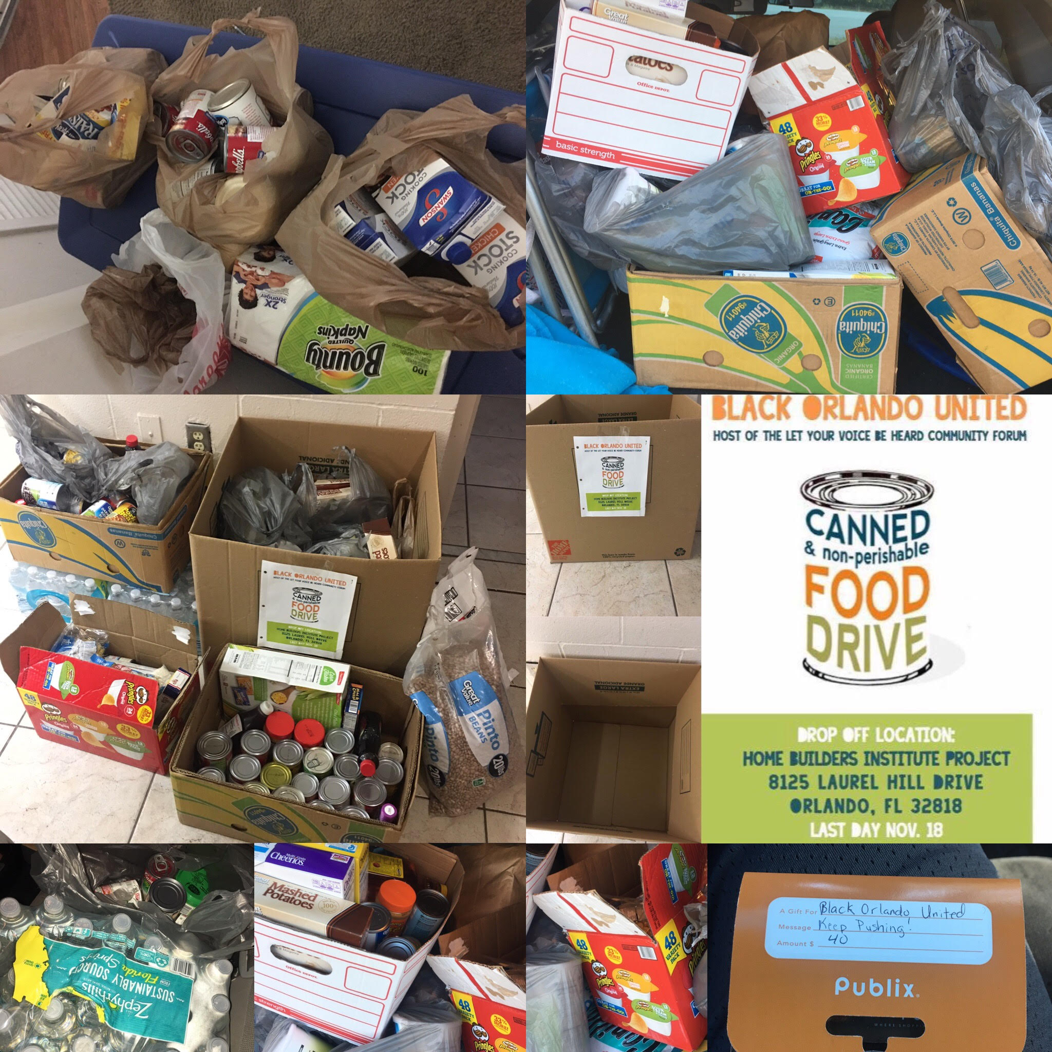
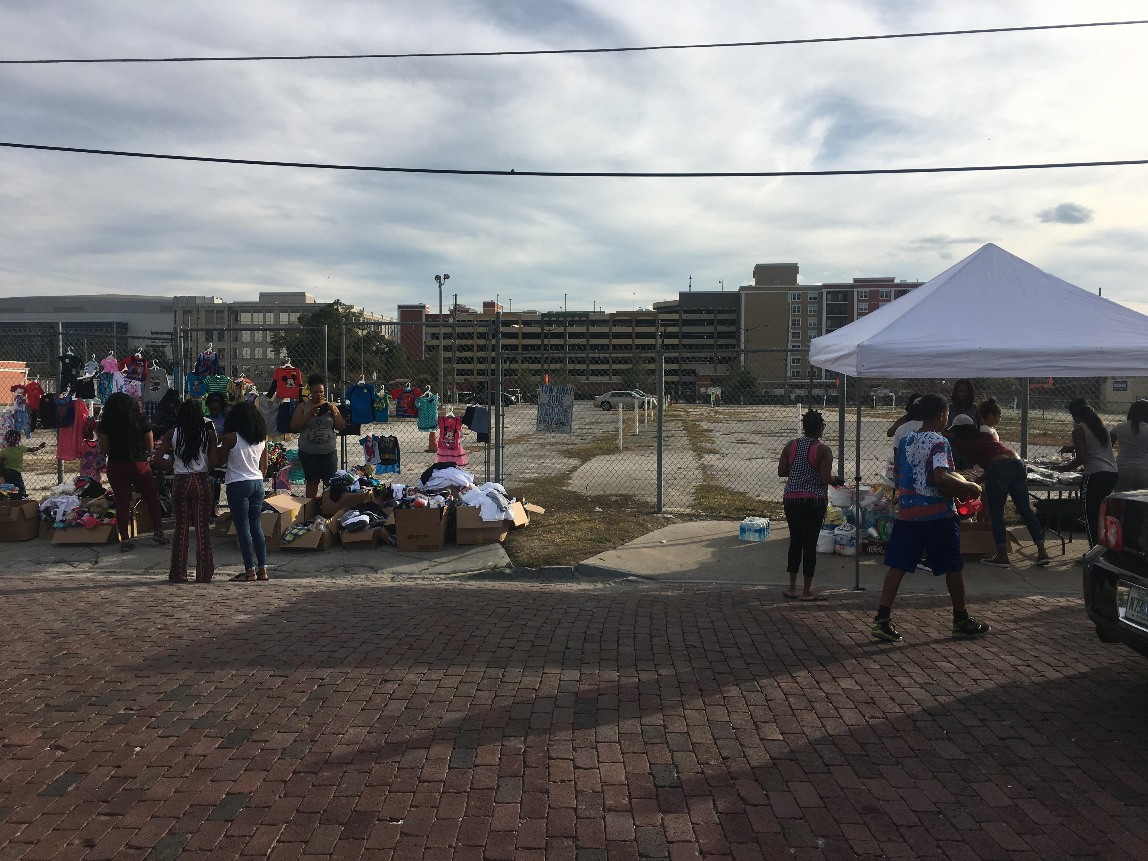
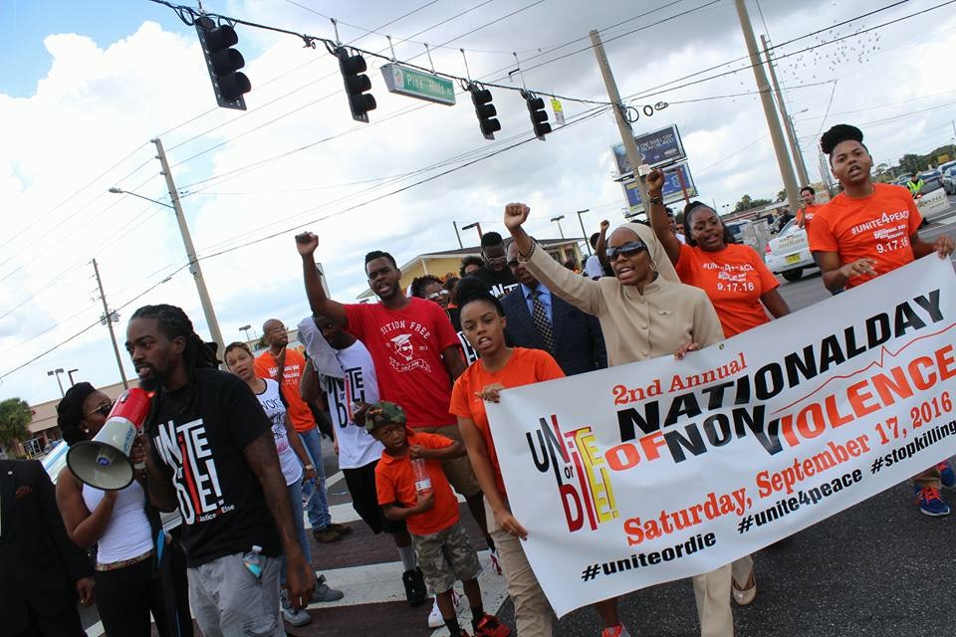
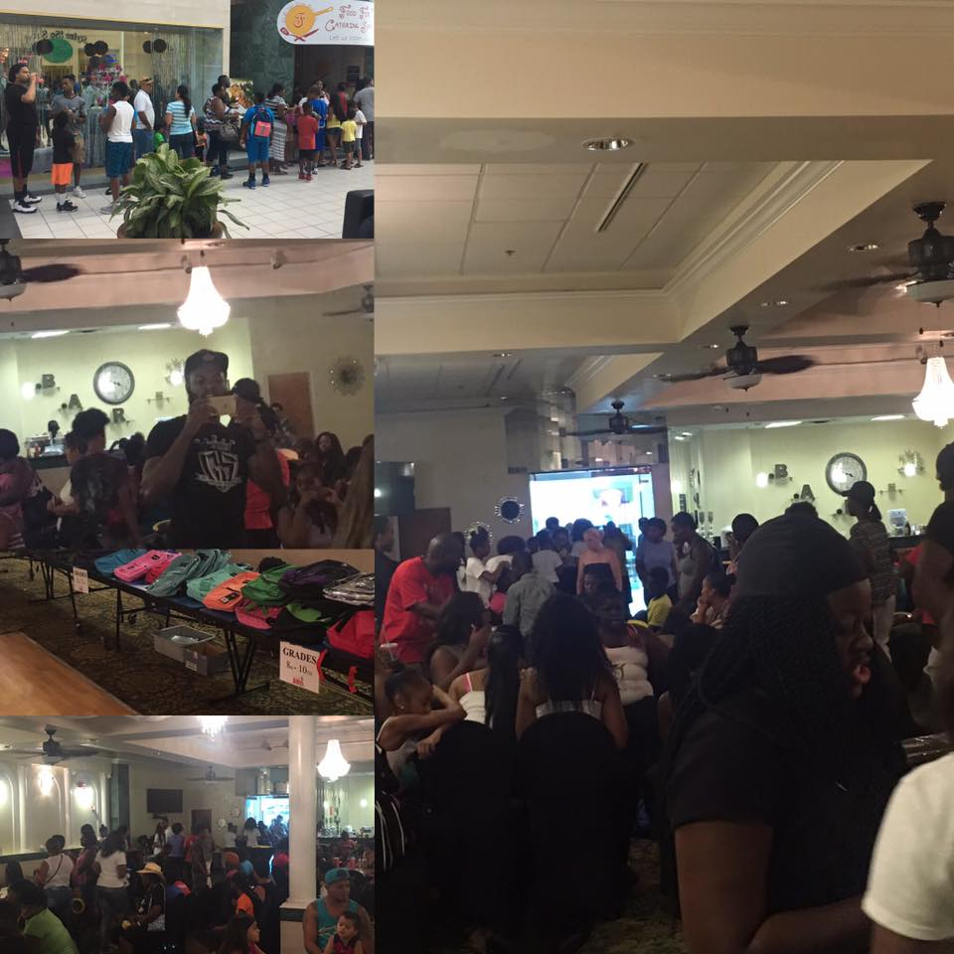
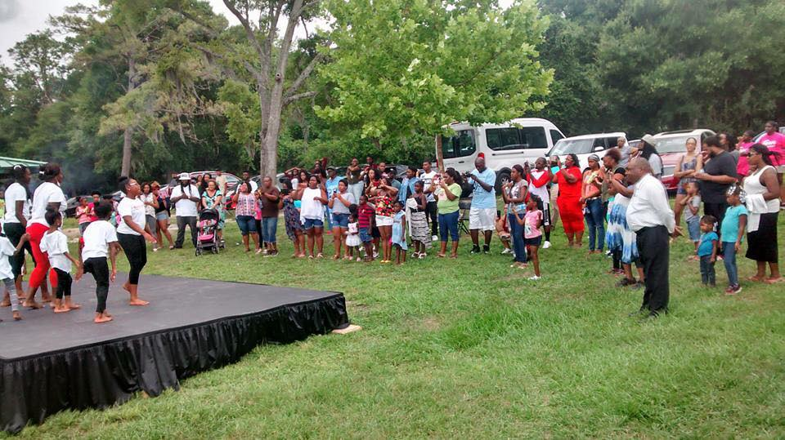
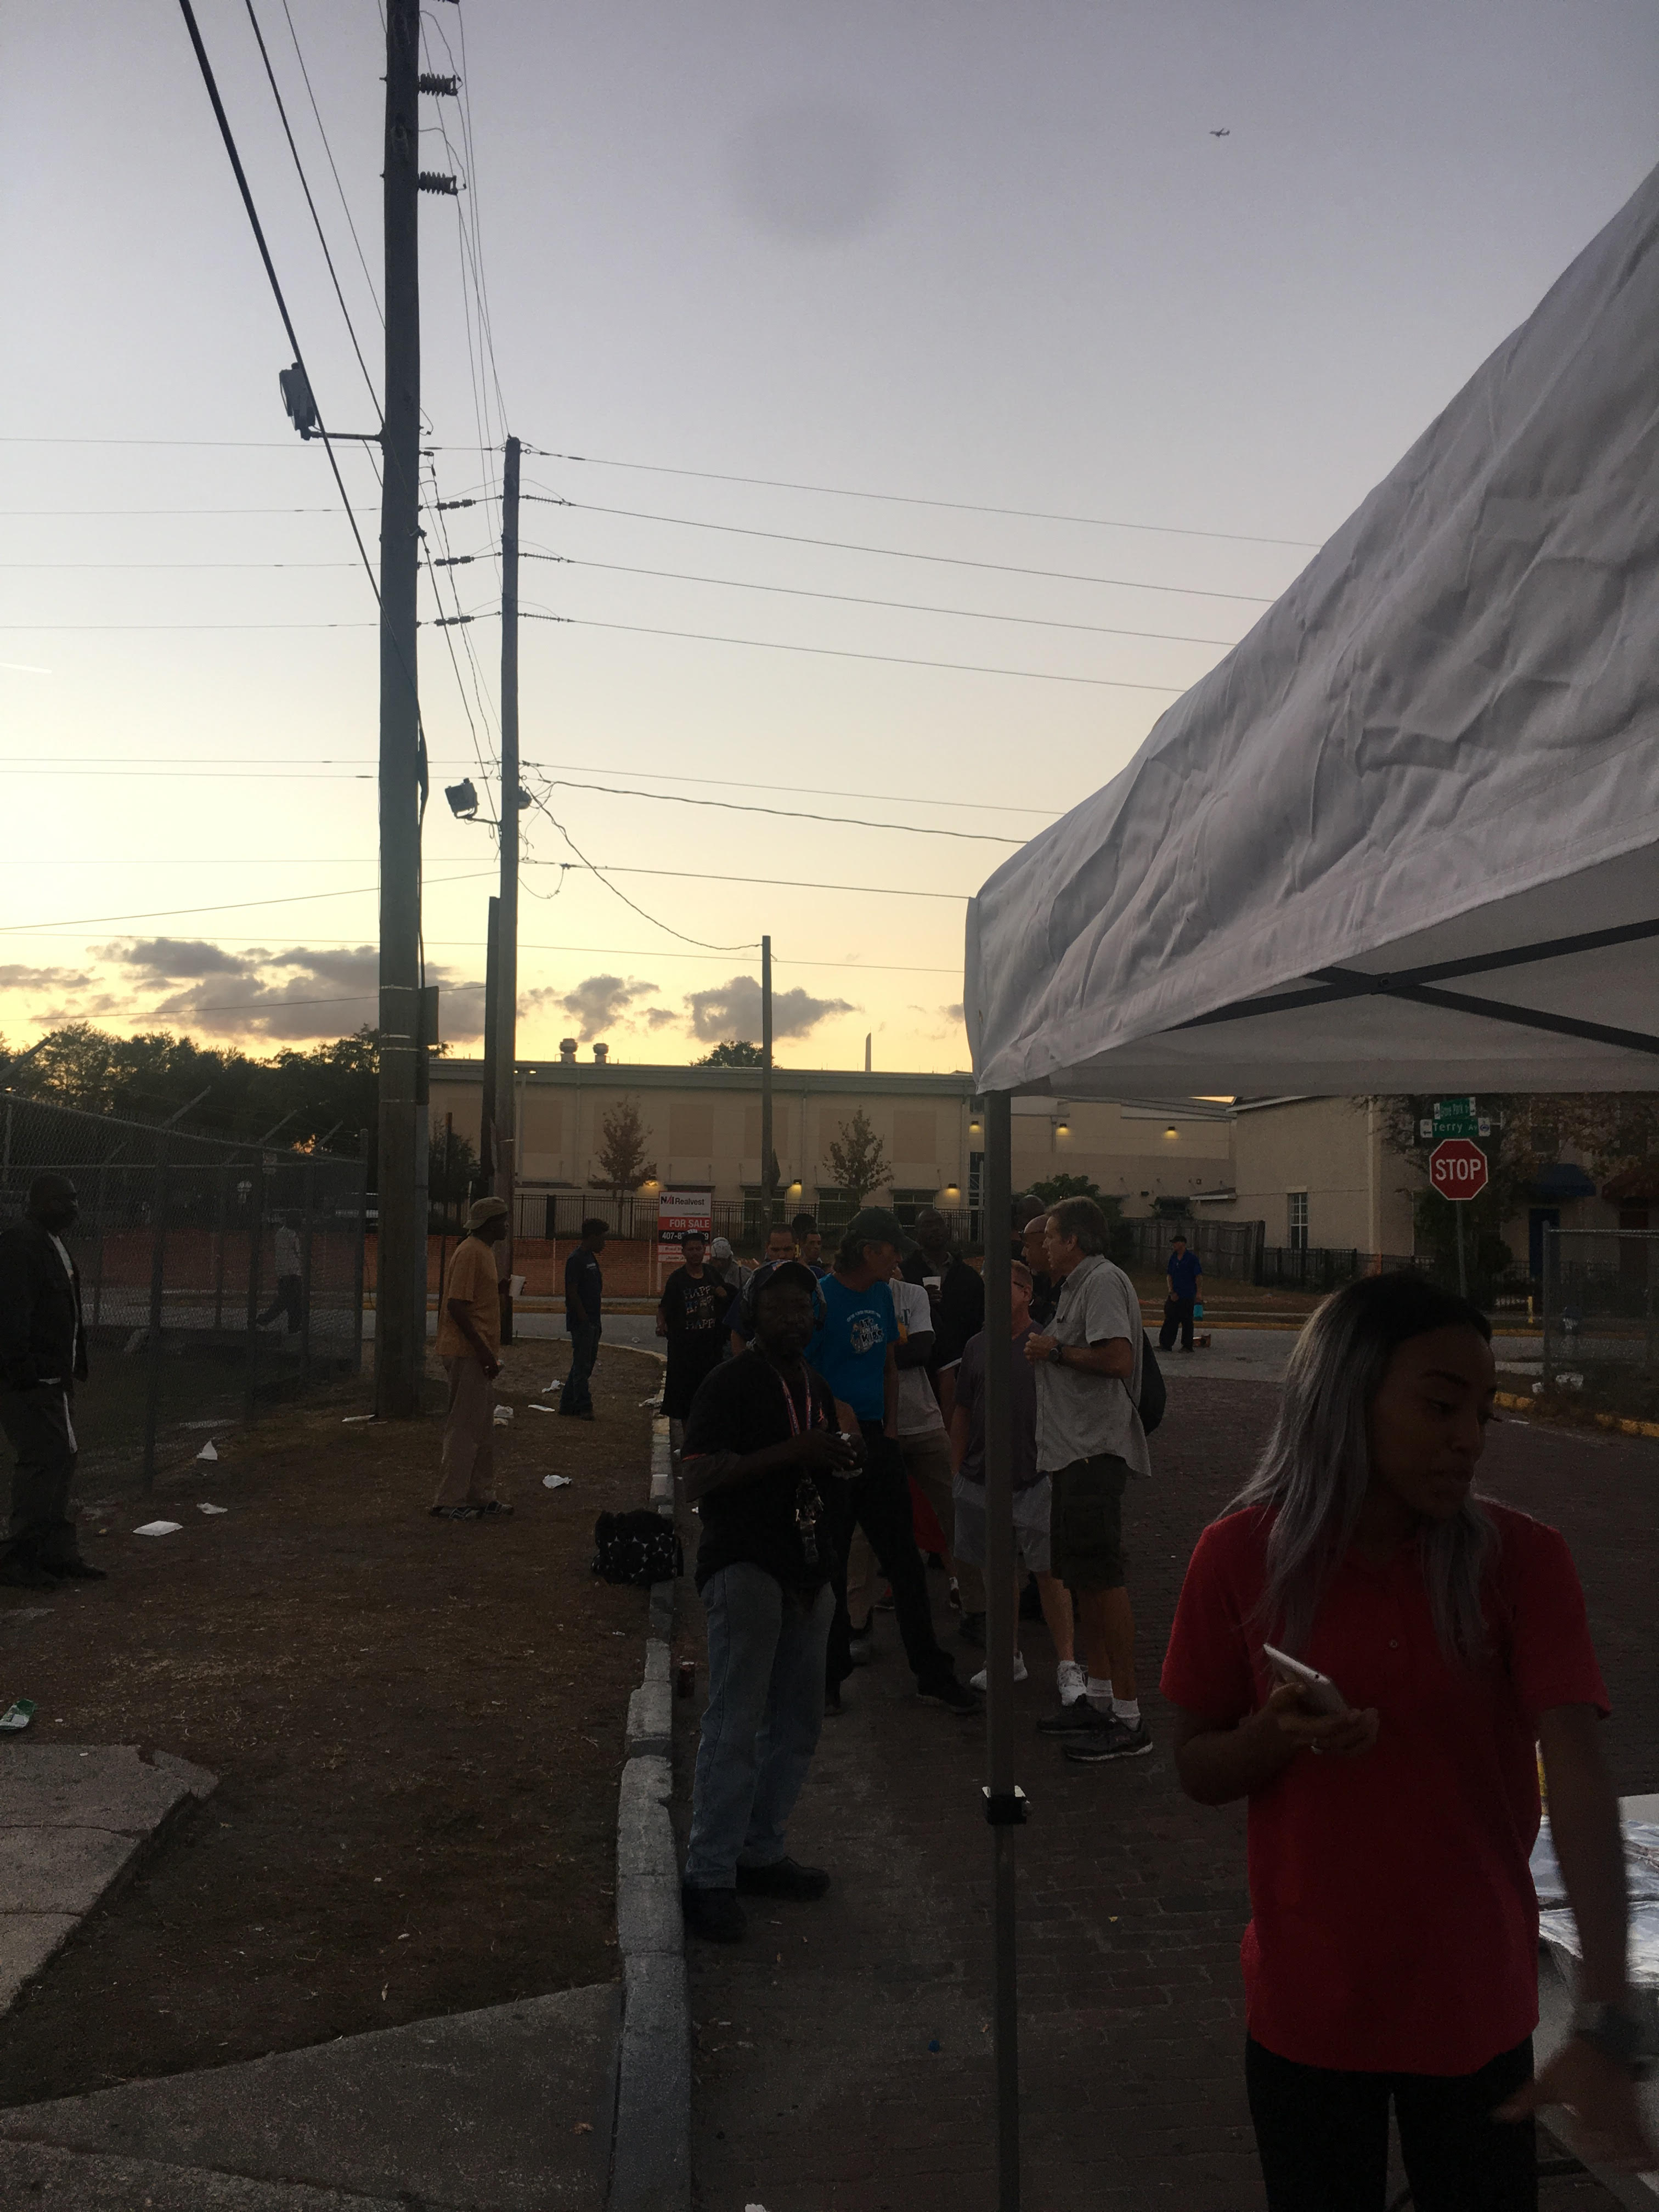
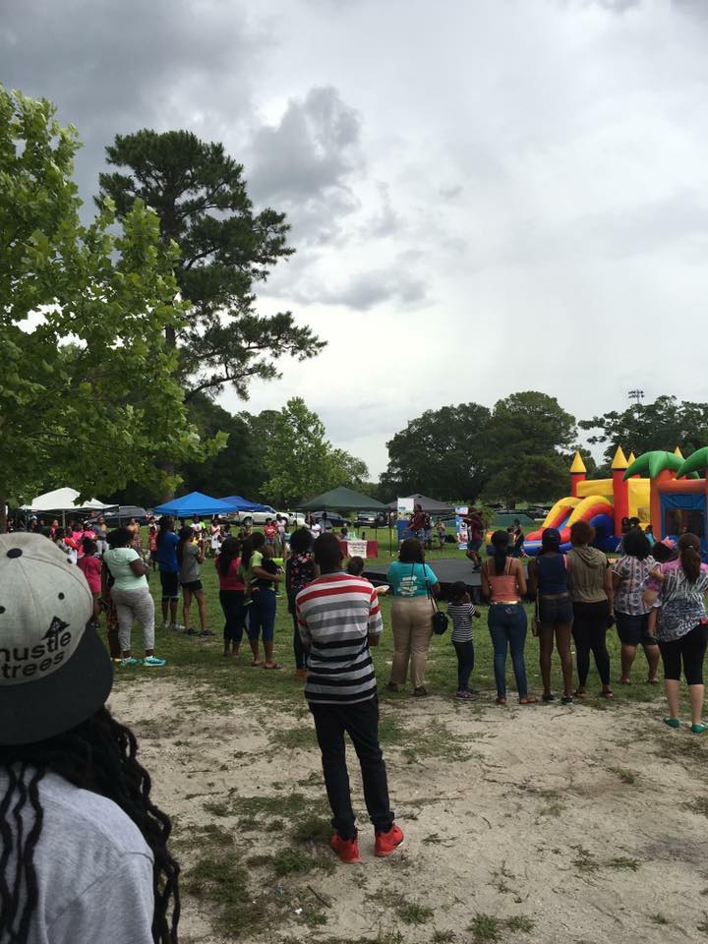
COMMUNITY OUTREACH

Slide 9
COMMUNITY OUTREACH
WE WILL BE CONDUCTING COMMUNITY OUTREACH WALKS ONCE A MONTH THAT WILL CONSIST OF US GOING OUT ON SATURDAYS (AT NOON) AND WALKING THROUGH NEIGHBORHOODS TO ENGAGE THE LOCAL RESIDENTS
FIRST ONE DATED FOR 01/23/2017
WE WILL HAVE AN OFFICAL T-SHIRT, THE COST IS $10 PER SHIRT BUT IT WILL LAST A LONG TIME
PROVIDED BY CSC (COMMUNITY SOLUTIONS COMMITTEE), WE CAN ASK SURVEYS THAT WILL FIND OUT IF A PERSON NEEDS EXTRA INCOME, LIFE INSURANCE, FOOD OR CASH ASSISTANCE, AND OTHER VARIOUS QUESTIONS TO SCREEN THE PERSON, AND FIND AN APPROPRIATE PROGRAM THAT CAN ASSIST THEM
DISTRIBUTE NEWSLETTERS THAT WILL FEATURE LIST OF FUTURE EVENTS, INFORMATION ABOUT THE FORUMS, AND OTHER RESOURCEFUL PROGRAMS AND ORGANIZATIONS OUT HERE

Slide 10
COMMUNITY OUTREACH
FOOD DRIVES FOR HOUSEHOLDS THAT NEED IT
OUR LAST FOOD DRIVE ENDED NOV 18TH AND WE HAVE FED 10+ FAMILIES SINCE THEN
HOMELESS FOOD/CLOTHES DRIVES (NEXT ONE SET FOR 02/11/2017)
BUILD A PROGRAM REFERNCE GUIDE THAT CAN BE PASSED OUT TO INDIVIDUALS THAT WILL LIST PROGRAMS THAT CAN HELP THEM IN VARIOUS FIELDS (FINANCIAL, HEALTH, EDUCATIONAL, ETC)
THIS WILL BE USED ON OUR OUTREACH
TO REFER YOUTHS TO MENTORING PROGRAMS ALREADY IN PLACE AND ALSO REFER ADULTS TO PROGRAMS THAT CAN ASSIST THEM ALSO

Slide 11
COMMUNITY OUTREACH
COMMUNITY FUN DAYS
WITH VENDORS FOR AFTER-SCHOOL AND MENTORING PROGRAMS, LIFE INSURANCE, NON PROFITS, AND MORE
BUILDS RAPPORT WITH LOCAL NEIGHBORHOODS AND INTRODUCES US TO AREA
SHOULD DO ONE IN EACH PREDOMINANTLY AFRICAN AMERICAN COMMUNITY OF ORLANDO, FL
CAN INVOLVE TALENT SHOWS WHERE YOUTHS SPEAK ABOUT STOPPING THE VIOLENCE AND POWER OF UNITY (WE’VE DONE ONE EARLIER THIS YEAR AT BARNETT PARK)

Slide 12
COMMUNITY OUTREACH
ANY SUGGESTIONS?

Slide 13
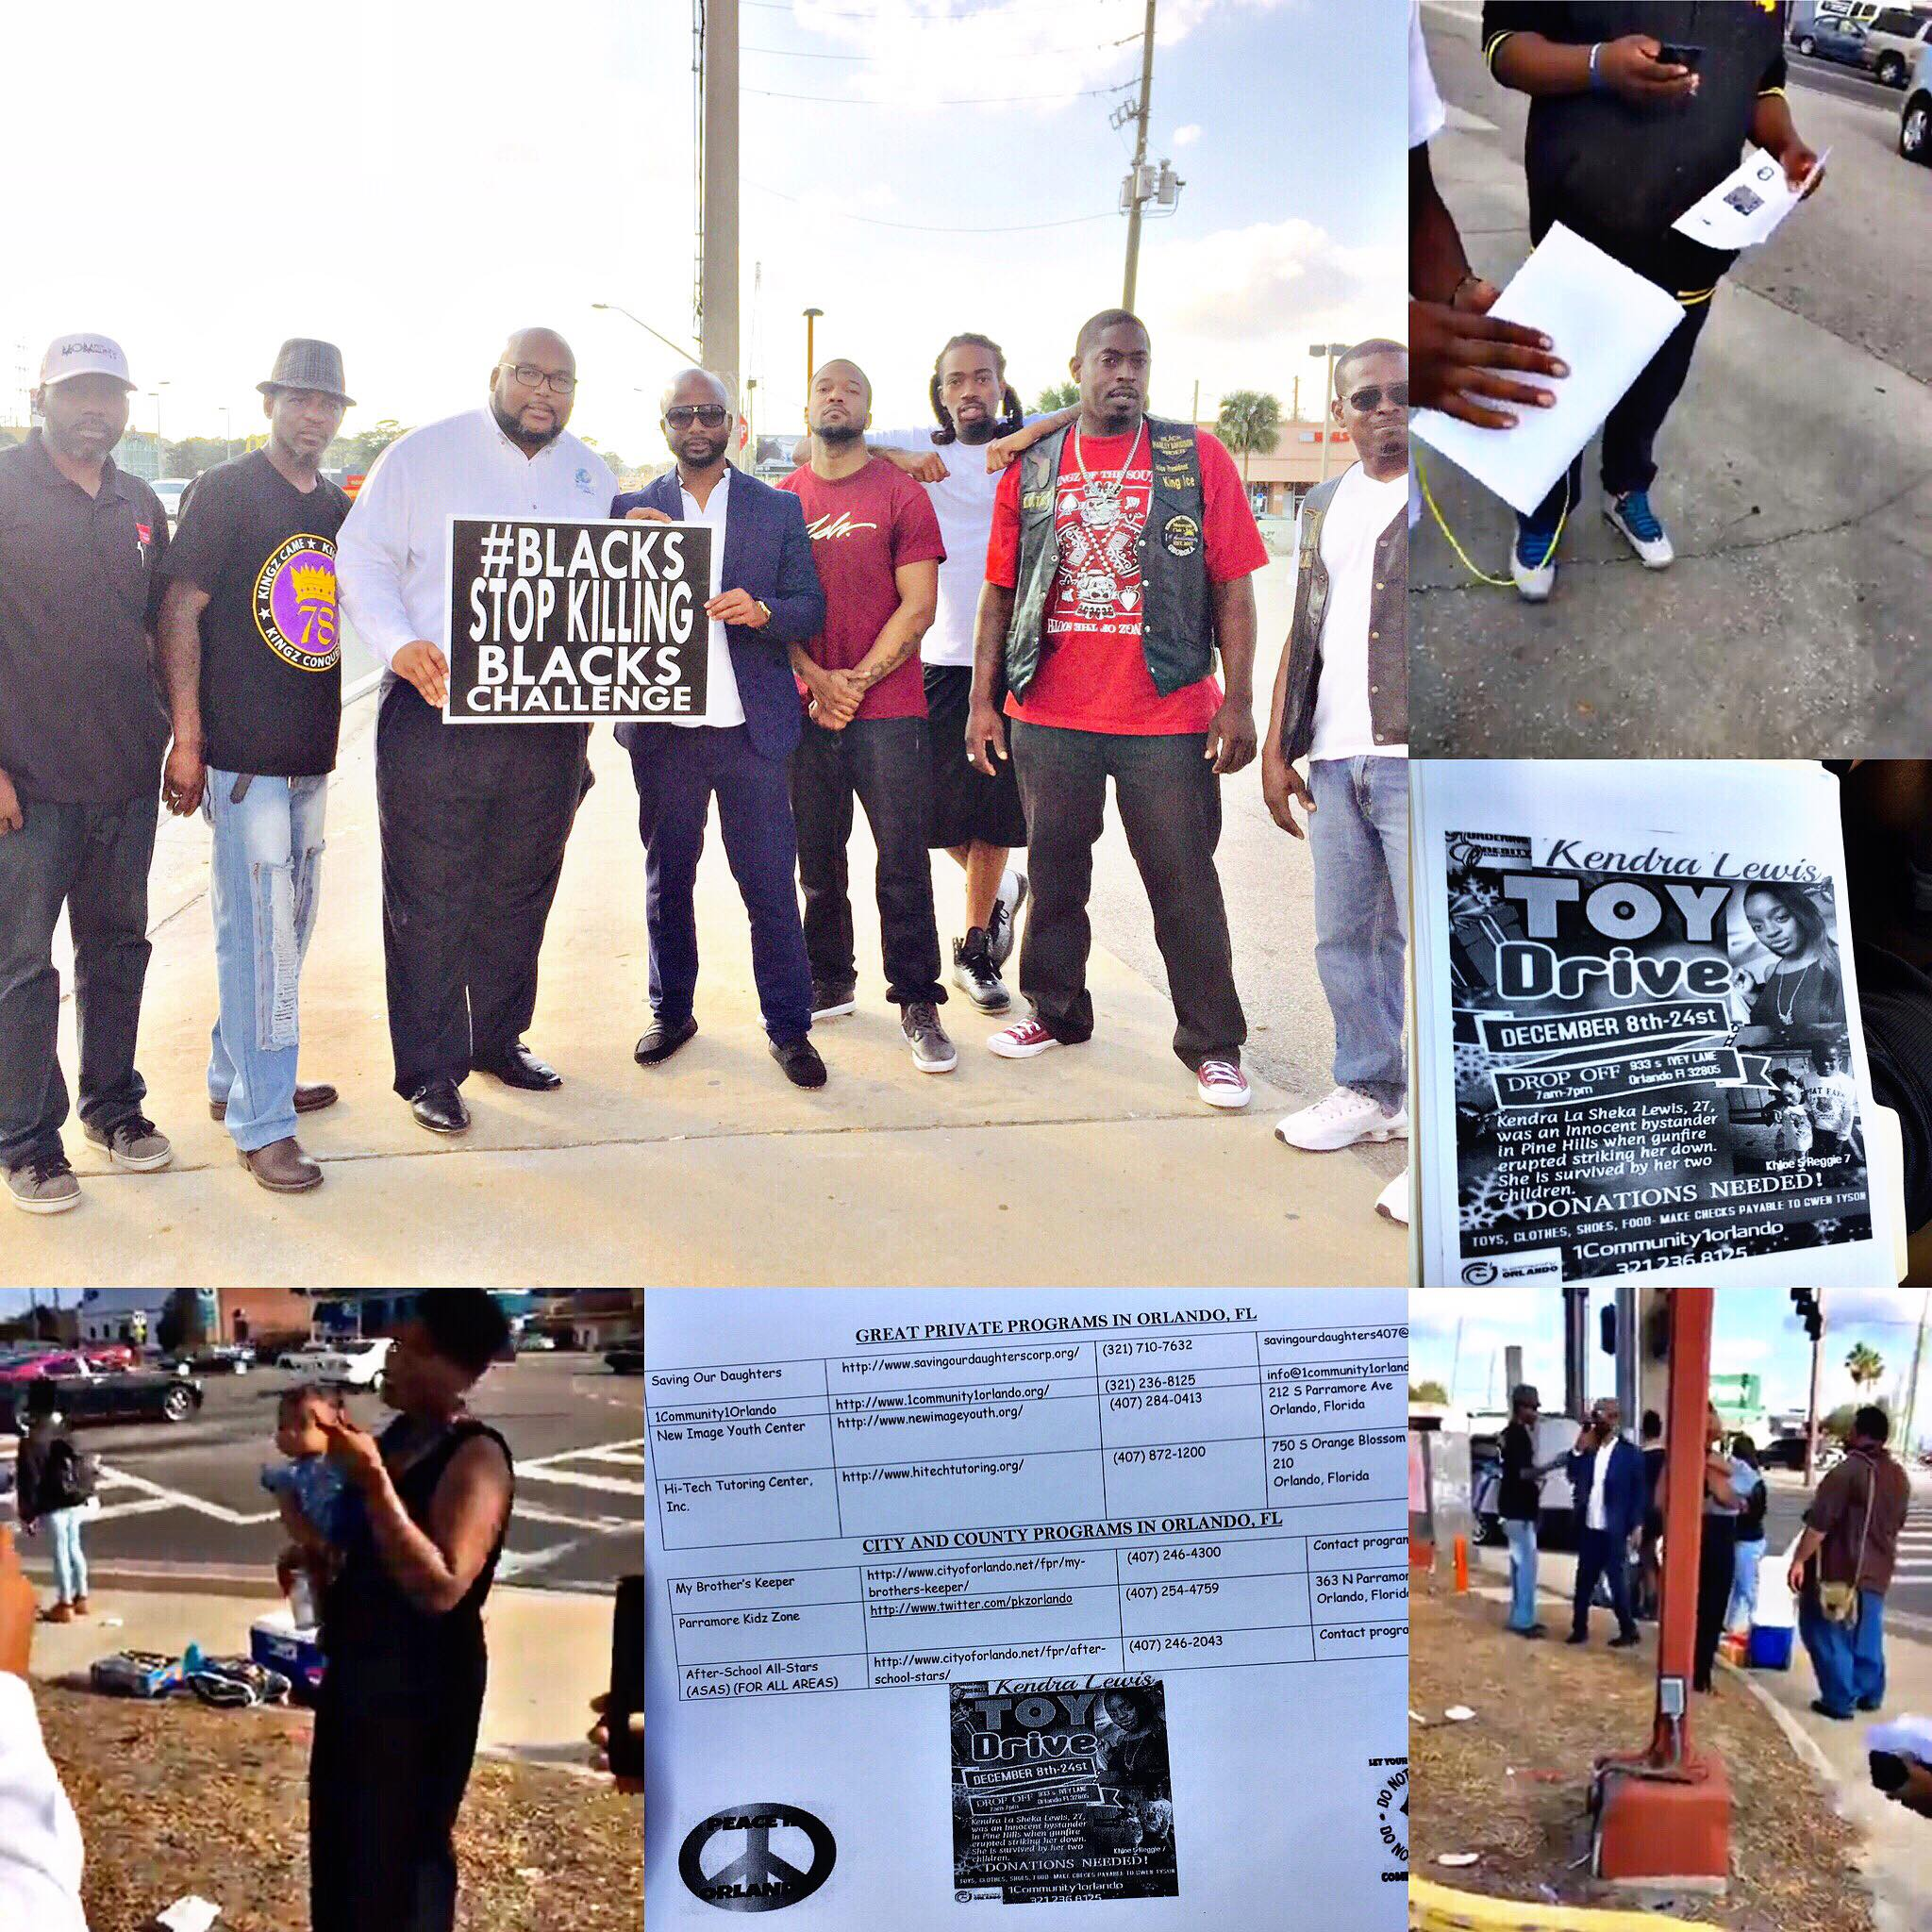
YOUTH OUTREACH

Slide 14
YOUTH OUTREACH
WE HAVE BEGUN YOUTH OUTREACH WHERE WE ATTEND THE HIGH SCHOOLS WHEN THEY GET OUT OF SCHOOL (MON, TUES, THUR, FRI- 2:30PM, WED-1:30PM) AND GREET YOUTH WITH CHIPS AND DRINKS
WE ALSO SUPPLY THEM WITH AN INFORMATIONAL SHEET FEATURING LOCAL AFTER-SCHOOL AND MENTORING PROGRAMS THEY CAN BE A PART OF
WE ALSO SPEAK WITH THE YOUTH ABOUT THE IMPORTANCE OF STAYING IN SCHOOL AND NEGATIVE INFLUENCES
WE HAVE RECEIVED GREAT RESPONSE FROM THE PARENTS AND YOUTH

Slide 15
YOUTH OUTREACH
TO CONTINUE YOUTH OUTREACH, WE WANT TO ATTEMPT TO BE AT 4 DIFFERENT SCHOOLS IN THE FUTURE (JONES HIGH SCHOOL, EVANS HIGH SCHOOL, MEADOWBROOK MIDDLE SCHOOL, MEMORIAL MIDDLE SCHOOL)
WE WILL NEED 4 PEOPLE AT EACH LOCATION, BUT IN THE BEGINNING WE WILL WORK WITH WHO WE HAVE
WE WILL NEED VARIOUS DONATIONS LIKE CHIPS, SNACKS, AND DRINKS
WE WILL ALSO PRINT OUT MATERIAL WITH INFORMATION THAT CAN ASSIST THE YOUTH (PROGRAMS SPREADSHEET)
WE WILL RESUME IN JANUARY (SCHOOL STARTS BACK 01/04/2017)

Slide 16
YOUTH OUTREACH
WE WILL ALSO HAVE OUTREACH ON SATURDAYS ONCE A MONTH
PICKUP FLAG FOOTBALL, BASKETBALL, KICKBALL GAMES, ETC.
INTERACTION WITH KIDS AND BUILD RAPPORT
WE CAN PROVIDE SNACKS AND DRINKS FOR REFRESHMENTS
WE ARE ALSO DOING A WORKSHOP FOR YOUNG MEN SOON THAT WILL FEATURE SPIRITUAL AND MENTAL GUIDANCE AND A TOUGH APPROACH FROM A MAN’S PERSPECTIVE
IN THE FUTURE WE WILL ALSO HAVE EDUCATIONAL WORKSHOPS FOR HOW TO BUILD RESUMES, DRESS PROFESSIONALLY, RESPECT PARENTS, AND JOB FAIRS.

Slide 17
YOUTH OUTREACH
ANY SUGGESTIONS?

Slide 18
COMMUNITY POLICING

Slide 19
COMMUNITY POLICING
WE HAVE ATTEMPTED IN THE PAST TO SET UP A NEIGHBORHOOD PATROL, OCSO HAS INFORMED US THAT IN ORDER TO DO AN OFFICIAL NEIGHBORHOOD PATROL WE WOULD TO BASE EACH ONE ON THE ADDRESS LISTED ON OUR I.D.
IN ORDER TO REMAIN MOBILE, WE CAN HAVE PRESCENCES IN THE NEIGHBORHOODS BUT CANNOT BE AN OFFICIAL NEIGHBORHOOD WATCH
WE CAN REFER MEMBERS OF EACH AREA ON THE STEPS THEY NEED TO TAKE TO BECOME NEIGHBORHOOD WATCH
WE CAN CONDUCT PEACE WALKS THROUGH NEIGHBORHOODS ONCE A MONTH AT NIGHT TO ENGAGE RESIDENTS AND SHOW OUR PRESENCE

Slide 20
COMMUNITY POLICING
WE WILL SERVE AS A PRESENCE IN THE NEIGHBORHOOD BUT WILL NOT BE INTERACTING WITH CRIME OF ANY FORM
WE WILL CONDUCT PEACE WALKS THROUGH NEIGHBORHOODS IN WHICH WE SHOW WE CARE AND ARE AWARE, AND ALSO REACH OUT TO RESIDENTS TO FIND OUT WHAT NEEDS THEY MAY HAVE
SURVERYS CAN BE IMPLEMNTED
THESE WILL BE DONE 6:30PM AT NIGHT, THROUGH ONE NEIGHBORHOOD, ONCE A MONTH
WE CAN BE A VISUAL PRESENCE THAT CAN DETER CRIME AND ALSO LAW ENFORCEMENT ABUSE
TARGET AREAS ARE:
PINE HILLS, CARVER SHORES, IVEY LANE, MERCY DRIVE, SEMORAN, APOPKA, PARRAMORE, AND ANY SURRONDING AREA
FIRST PEACE WALK IS DATED FOR 01/31/17 AT 6:30 PM MEETING AT PINE HILLS AND SILVER STAR RD.
PLEASE ACT NOW IF YOU WANT A T-SHIRT

Slide 21
COMMUNITY POLICING
ANY SUGGESTIONS?

Slide 22
EMPOWERMENT
WE CAN HELP EMPOWER THE RESIDENTS AND YOUTH OF ORLANDO, FL BY PROMOTING PROGRAMS ALREADY IN PLACE (MENTORING, FINANCIAL, EDUCATIONAL, ASSISTANCE, ETC)
PROGRAM SHEETS ARE BEING WORKED ON THAT CAN BE DISTRIBUTED THROUGH NEIGHBORHOODS
WORKSHOPS FOR FUTURE (GRANT WRITING, CONCEALED WEAPON PERMIT, OCOEE MASSACRE, KNOW YOUR RIGHTS, ETC)
WORKSHOPS WILL HELP EMPOWER PEOPLE THROUGH KNOWLEDGE AND INFORMATION
FINANCIAL WORKSHOPS IN THE FUTURE CAN BE FIRST –TIME HOME BUYER’S PROGRAM, CREDIT REPAIR, DAY TRADING TIPS, ETC

Slide 23
EMPOWERMENT
PLEASE WORK ON 3 EMPOWERMENT EVENTS (WORKSHOPS, ETC) THAT WE CAN DO THROUGHOUT THE YEAR
WE CAN FORM COMMITTEES FOR EACH ONE AND COORIDNATE EVENTS BEFORE HAND
ANY SUGGESTIONS?

Slide 24
CITY COUNCIL AND ORANGE COUNTY MEETINGS
We can meet at Forums and among ourselves but unless we propose our ideas to the elected officials of the local government, changes will not be made
If we don’t attend meetings we can look up our local officials online and write them with our concerns, there is power in keeping records of our requests.
We have to do research on each topic we suggest to have changed
We can attend the upcoming meeting JANUARY 9TH at city hall, 9:00 am, many organizations like 1community1Orlando and my brother’s keeper will be making initiatives and need our physical support
Send ideas to info@blackorlandounited.com

Slide 25
CITY COUNCIL AND ORANGE COUNTY MEETINGS
UPCOMING AGENDA FOR ORLANDO CITY COUNCIL MEETING 01/09/2017 (2:00PM):
http://www.cityoforlando.net/cityclerk/city-council-calendar/
IN ORDER TO APPEAR BEFORE COUNCIL YOU MUST FILL OUT FORM AT CITY HALL
UPCOMING AGENDA FOR ORANGE COUNTY BOARD OF COUNTY COMMISSIONERS MEETING 01/03/2017 (9:00AM) :
http://www.orangecountyfl.net/BoardofCommissioners/eAgenda.aspx#.WGVTxPkrK00
IN ORDER TO APPEAR BEFORE COUNCIL :
Http://www.orangecountyfl.net/BoardofCommissioners/BoardAppearanceRequest.aspx#.WGVTn_krK00

Slide 26
Suggestions made at the last forum for the City AND COUNTY Council Meetings
Changes of the hiring process for the education system, having the employment become more diverse.
Changes made to the expungement system for misdemeanor and felony charges and convictions, in order to reduce the waiting time, and expand the range of what crimes can be expunged.
Easier versions of the budget released, online preferably.
More contracts be pushed to African American and other ethnic groups for construction, security, and real estate in Orange County.
More small business grants for residents of Orange County.
Better housing for single mothers and kids, and to also include single father, and men more in the housing opportunities for residents.

Slide 27
Suggestions made at the last forum for the City AND COUNTY Council Meetings
Law enforcement releases toxicology of each police officer involved in a shooting.
The process for all police officer involved shooting be made to have mandatory unpaid leave.
If an officer is out on leave for a shooting, they are not allowed to work any jobs that may require a gun (security, etc.).
To have the definition of “Imminent threat” reviewed for the provision of lethal force.
More free programs for trade school, technical school, and learning second languages.
More agriculture training provided through the school system for young students
More opportunities created for high school students to have a pipeline directly to trade school

Slide 28
Suggestions made at the last forum for the City AND COUNTY Council Meetings
PLEASE SEND ALL NEW DETAILED SUGGESTONS TO INFO@BLACKORLANDOUNITED.COM

Slide 29
SUPPORTING PROGRAMS ALREADY IN PLACE
MENTORING PROGRAMS
SAVING OUR DAUGHTERS
http://www.savingourdaughterscorp.org/
Great program for young women, with regular meetings and character building events.
Presentation from Saving Our Daughters

Slide 30
SUPPORTING PROGRAMS ALREADY IN PLACE
MENTORING PROGRAMS
My Brother’s Keeper
An initiative began by President Obama
They frequent local schools and talk to young boys and girls about the importance of education, and help character-build.
You can find out more ways to be involved with this program by emailing us at info@blackorlandounited.com

Slide 31
SUPPORTING PROGRAMS ALREADY IN PLACE
MENTORING PROGRAMS
Parramore Kidz Zone
Great program for the Parramore area
Sign up at 363 N Parramore Avenue 363 N Parramore Ave Orlando, Florida
Call (407) 254-4759
Strategy of Parramore Kidz Zone: - Identify a community challenged by high levels of crime and poverty, where children disproportionately drop out of school and enter the juvenile justice system - Deploy a full time outreach team to the zone, build strong relationships with neighborhood youth and families, door-to-door and street-by-street, mobilizing folks to take back their community.

Slide 32
SUPPORTING PROGRAMS ALREADY IN PLACE
Mentoring programs
New image youth center
Call (407) 284-0413
212 S PARRAMORE AVE ORLANDO, FL
Company Overview
New Image Youth Center (NIYC) was founded in June of 2004, in the Parramore Community. The youth of Parramore face many challenges, from drugs to alcohol to broken homes to peer pressure to weapons; everyday a child goes out into the world is a risk. New Image is the refuge of 50 youths, from the unhealthy, dangerous and sometimes deadly streets that they normally frequent. The NIYC is typically comprised of about 50 children from the surrounding neighborhoods everyday between the ages of 5 and 19, who need a place to go to just be kids.

Slide 33
SUPPORTING PROGRAMS ALREADY IN PLACE
Youth program
1 community 1 Orlando
Employing youth and building character
Mission
Our mission to engage in community based solutions that promote the well-being of children and families in the communities of Orlando and Orange County. OneCommunityOneOrlando assist the community by partnering with both public and private organizations by sharing its best practices and advocating for neighborhood reform across Orlando and beyond. .

Slide 34
SUPPORTING PROGRAMS ALREADY IN PLACE
AT RISK PROGRAM FOR YOUTH
HBI/ECKERD KIDS
CAN USE MALE MENTORS
407-297-1696
WWW.HBI.ORG
8125 LAURELL HILL DR ORLANDO, FL 32818

Slide 35
SUPPORTING PROGRAMS ALREADY IN PLACE
PLEASE SEND US ANY INFORMATION YOU HAVE ON PROGRAMS THAT WE CAN FEATURE
INFO@BLACKORLANDOUNITED.COM

Slide 36
Upcoming community events

Slide 37
Upcoming community events

Slide 38
Upcoming community events

Slide 39
Upcoming community events

Slide 40
LET YOUR VOICE BE HEARD COMMUNITY FORUM NEWSLETTER

Slide 41
LET YOUR VOICE BE HEARD COMMUNITY FORUM NEWSLETTER
WE WILL ACCEPT CONTRIBUTIONS TO THE NEWSLETTER
WE ALSO WANT TO ADVERTISE 3 MENTORING/YOUTH PROGRAMS PER MONTH AND 3 COMMUNITY EVENTS
WE WILL DISTRIBUTE PHYSICALLY, BUT WE CAN ALSO DISTRIBUTE ELECTRONICALLY
PLEASE SEND ANY SUGGESTIONS TO INFO@BLACKORLANDOUNITED.COM

Slide 42
“LET YOUR VOICE BE HEARD COMMUNITY FORUM” OPEN FLOOR
PLEASE TAKE THIS TIME TO ADVERTISE ANY PROGRAMS/ OPPORTUNITIES YOU HAVE.
OUR GOAL IS TO PROMOTE ORGANIZATIONS ALREADY IN PLACE AND HELP BUILD THEM UP.

